Slide 1


Medical Isotope Production at Berkeley
Andrew S. Voyles
19 May 2017
2017 Nuclear Physics Summer School in Oslo

Slide 2
Overview
Berkeley is currently leading a targeted experimental campaign to address these needs:
(n,p) production cross sections – UCB
Stacked-target charged particle excitation functions – LBNL / LANL
Tunable quasi-monoenergetic neutron source – LBNL

Slide 3
⁶⁴Cu and ⁴⁷Sc (n,p) Cross-Section Measurements for Medical Radionuclide Production
___________________________
^{UCB}

Slide 4
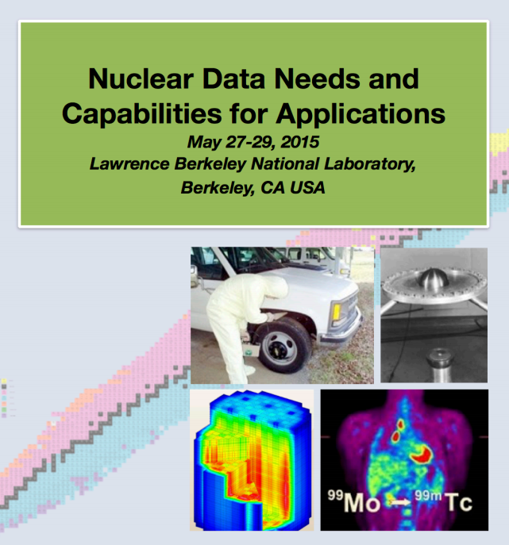
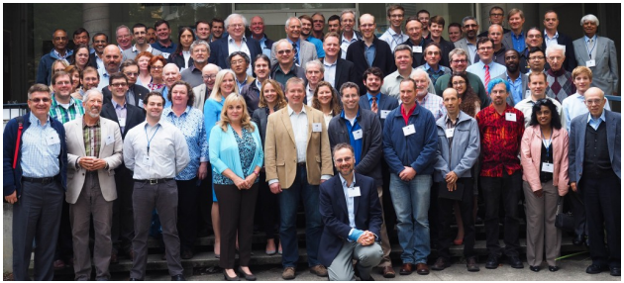
Some perspective
Notes:
Dr Qaim - plenary speaker and instigator of priority isotopes

Slide 5
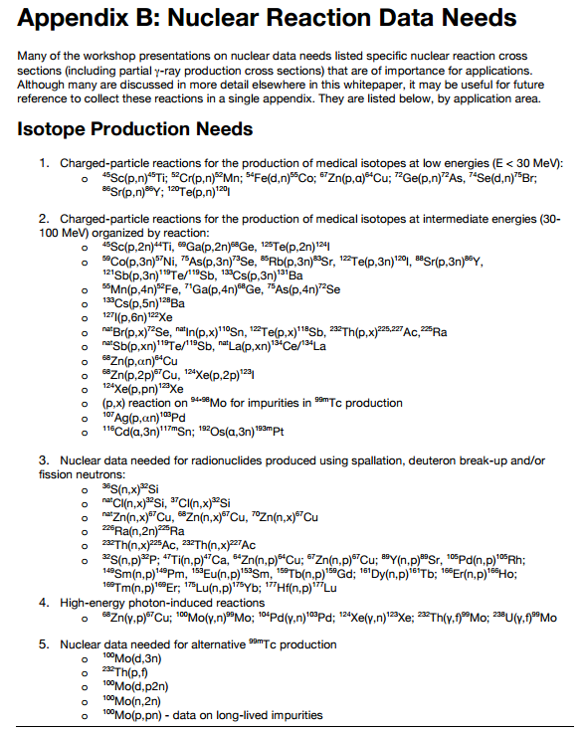
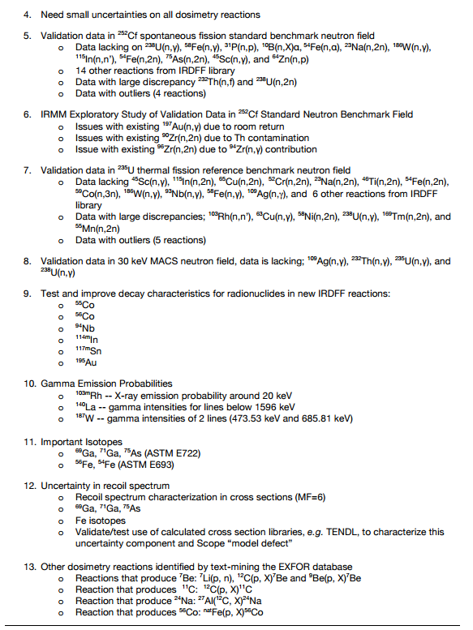
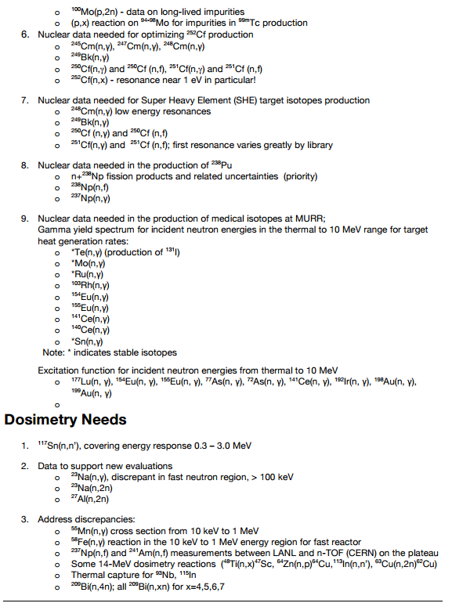
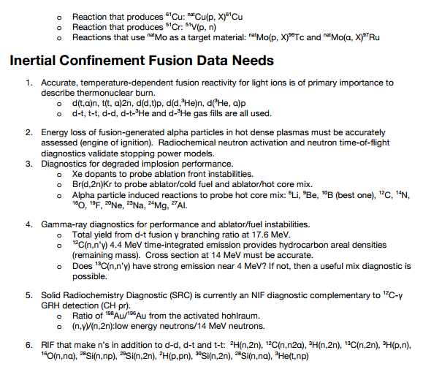
Some perspective
Highlight from WTTC 2016: ⁵⁴Fe(p,α)⁵¹Mn
NDNCA Whitepaper available at http://bang.berkeley.edu/events/ndnca/whitepaper/

Slide 6
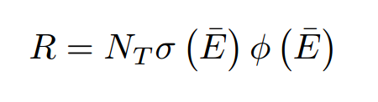
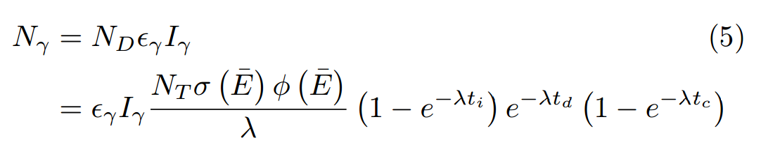
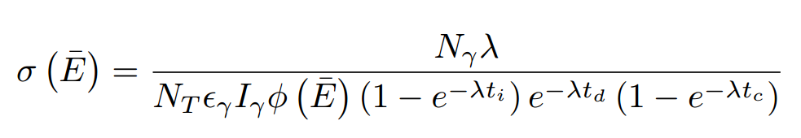
Cross-Section Systematics

Slide 7
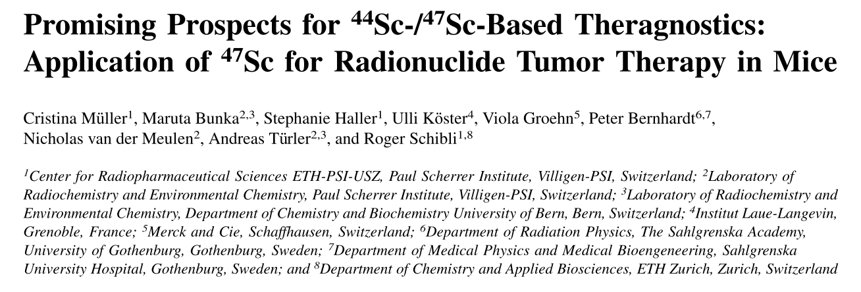
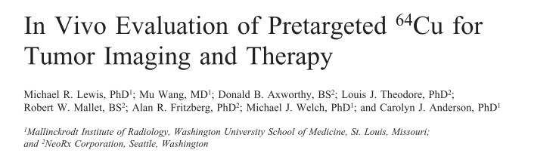
Medical Applications
Emerging medical radionuclides
⁶⁴Cu (t_{1/2} = 12.7 hr) – 61% β⁺ to ⁶⁴Ni, 39% β⁻ to ⁶⁴Zn
⁴⁷Sc (t_{1/2} = 3.35 d) – β⁻ to ⁴⁷Ti, with 159-keV γ

Slide 8
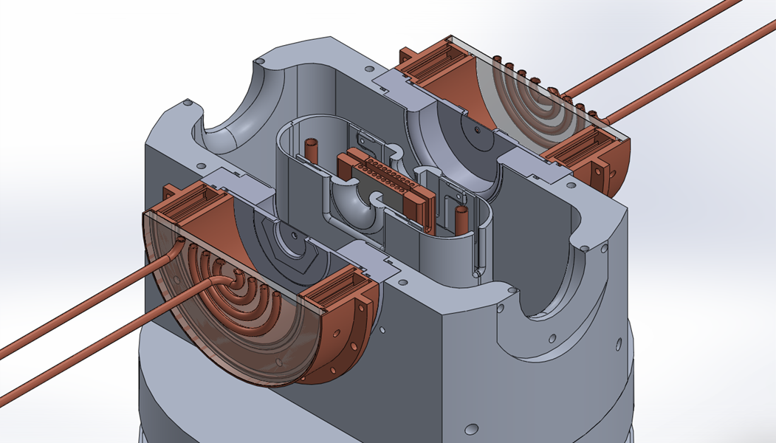
The UC Berkeley High Flux Neutron Generator
2.45 MeV neutrons, 10⁸ n/s/cm²
Extraction Plate: 5mm diameter
Commissioning:
25 July 2015
D Plasma
100kV
RF
DD Fusion
D beam
1-1000mA
Deuterium Gas
H₂O

Slide 9
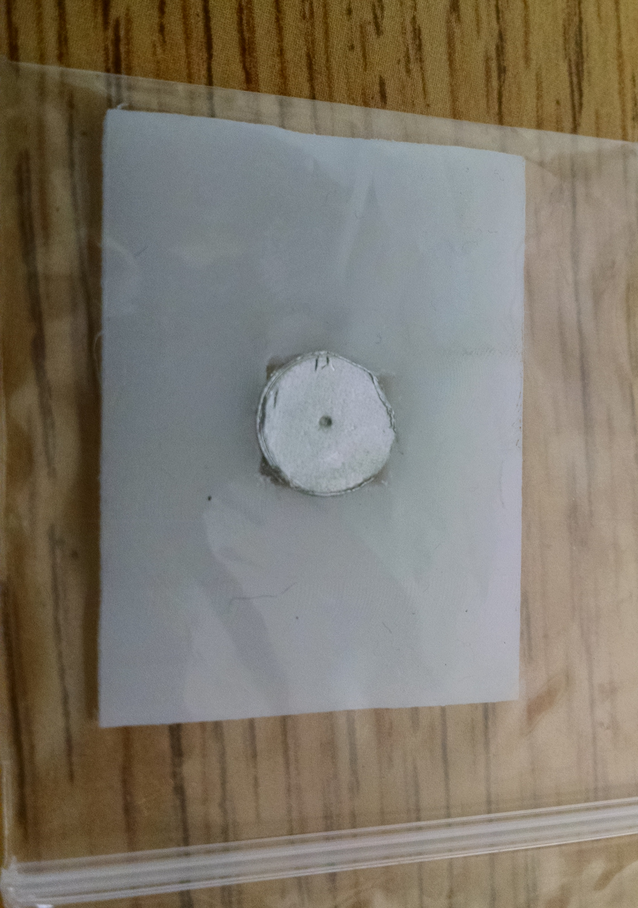
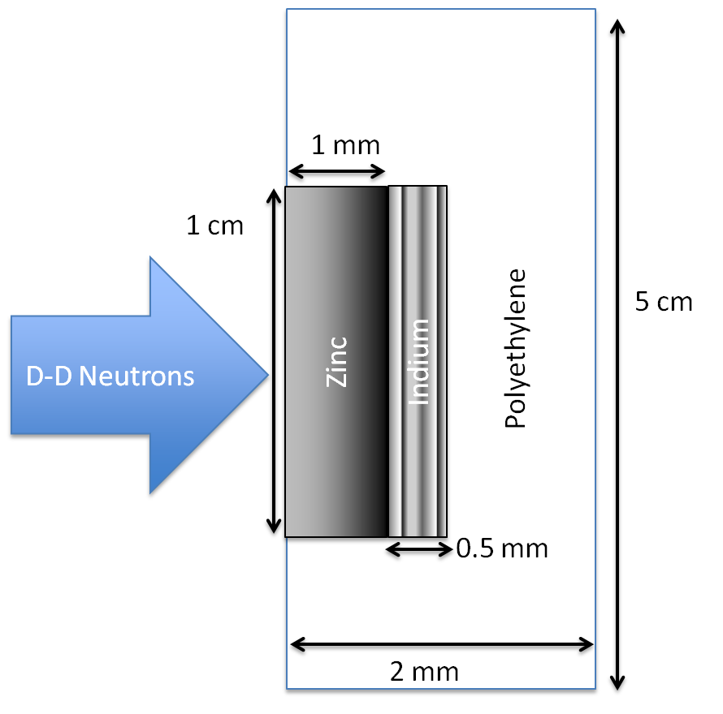
The UC Berkeley High Flux Neutron Generator
Foils Used | Metal Purity | Abundance (a/o) | Foil Density (mg/cm²)
^{nat}In | > 99.999% | ¹¹³In (4.29%), ¹¹⁵In (95.71%) | 365.5
^{nat}Zn | > 99.99% | ⁶⁴Zn (49.17%) | 714.1
^{nat}Ti | 99.999% | ⁴⁷Ti (7.44%) | 450.6
Notes:
64Zn - 49.17%, 66Zn – 27.73%, 67Zn – 4.04%, 68Zn – 18.45%
46Ti – 8.25%, 47Ti – 7.44%, 48Ti – 73.72%, 49Ti – 5.41%, 50Ti – 5.18%

Slide 10
The UC Berkeley High Flux Neutron Generator
Zn
Zn
In
In

Slide 11
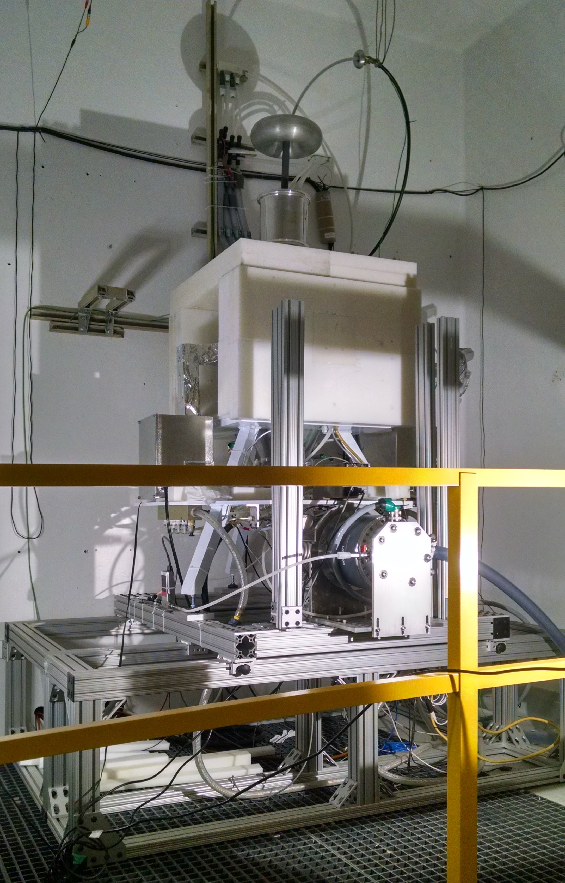
The UC Berkeley High Flux Neutron Generator
Zn
In

Slide 12
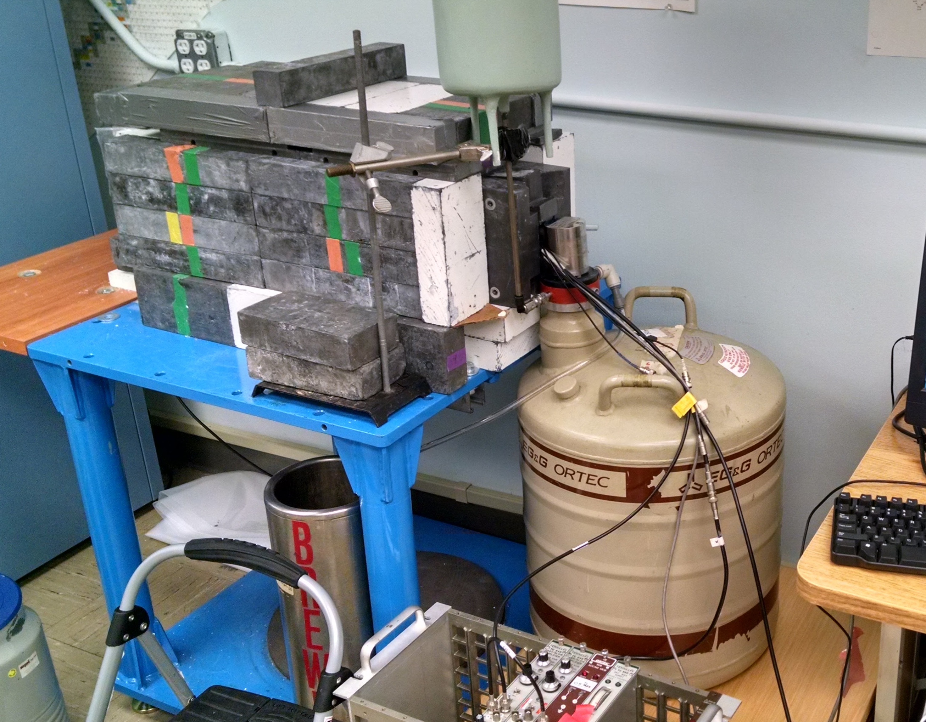
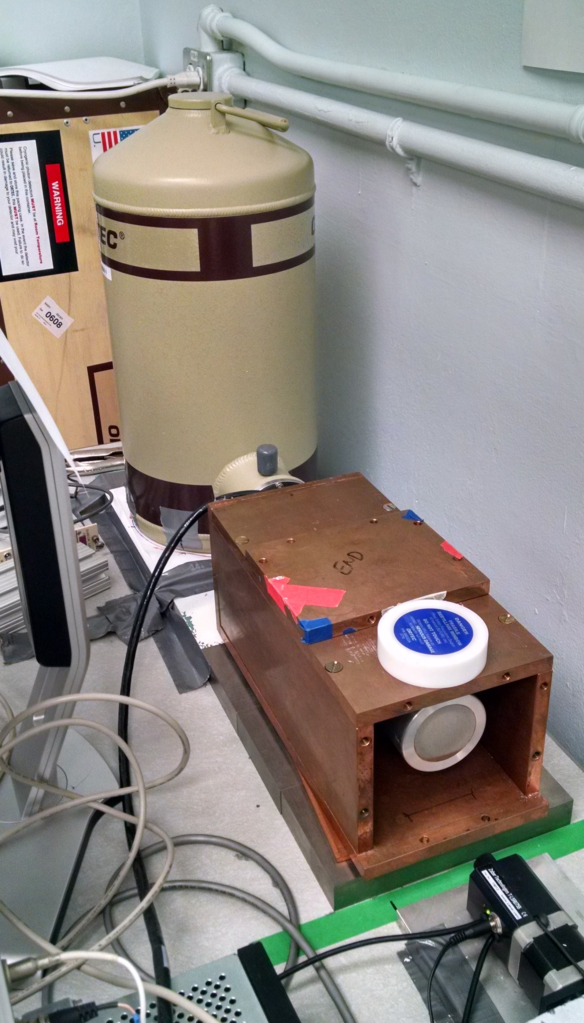
Relative Activation Measurements
Ortec Planar LEPS detector
Ortec 80% HPGe detector

Slide 13
Relative Activation Measurements

Slide 14
Relative Activation Measurements
t_{1/2} = 4.519 ± 0.044 h
(ENSDF = 4.486 h)
χ² /ν = 1.656
t_{1/2} = 12.097 ± 0.8348 h
(ENSDF = 12.701 h)
χ² /ν = 1.743
Notes:
Producing O(10 kBq), with dead time < 5%

Slide 15
Relative Activation Measurements
What’s going on???

Slide 16
Neutron Energy Spread
n
n
θ
n
Titanium
d
D
n

Slide 17
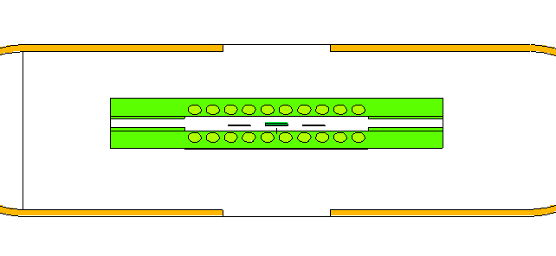
Neutron Energy Spread
Neutron Energy Spread
H. Liskien et al., Nucl Data Tables, vol 11, 2973
Neutron flux profile modeled in target and monitor foil, using MCNP6

Slide 18
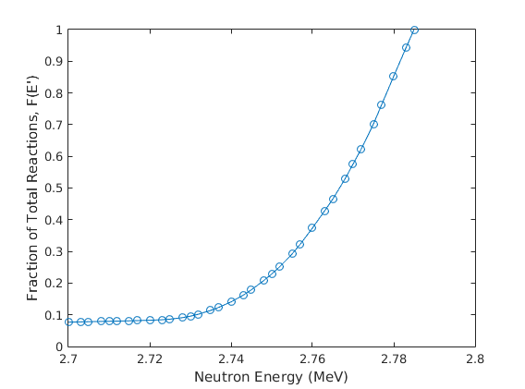
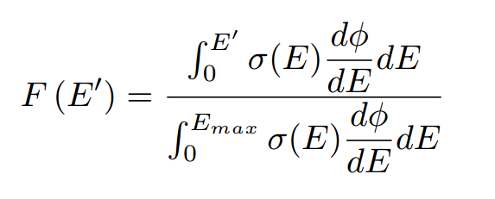
Neutron Energy Spread
Neutron Energy Spread
H. Liskien et al., Nucl Data Tables, vol 11, 2973
Neutron flux profile modeled in target and monitor foil, using MCNP6
-σ_{<E>}
<E>
+σ_{<E>}
E_{max} = Maximum energy neutron subtended by foil
F(E’) = Fraction of Total Reactions induced up to energy E’

Slide 19
Neutron Energy Spread
⁶⁴Zn(n,p)⁶⁴Cu
Before…
⁴⁷Ti(n,p)⁴⁷Sc

Slide 20
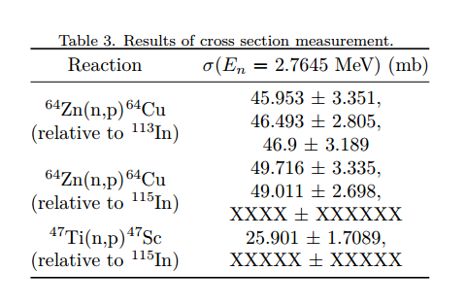
Neutron Energy Spread
⁶⁴Zn(n,p)⁶⁴Cu
After!
⁴⁷Ti(n,p)⁴⁷Sc

Slide 21
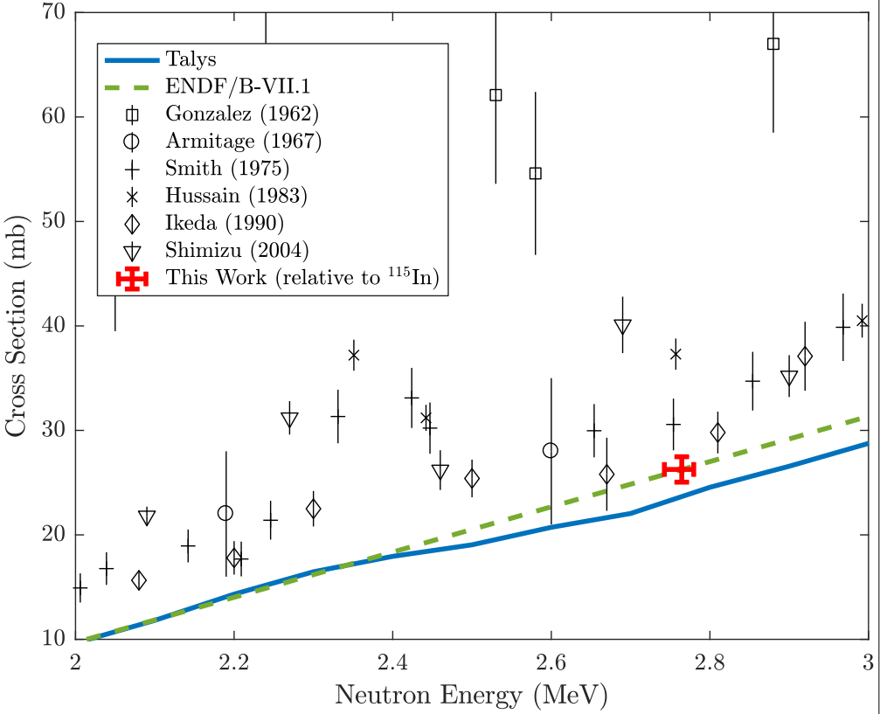
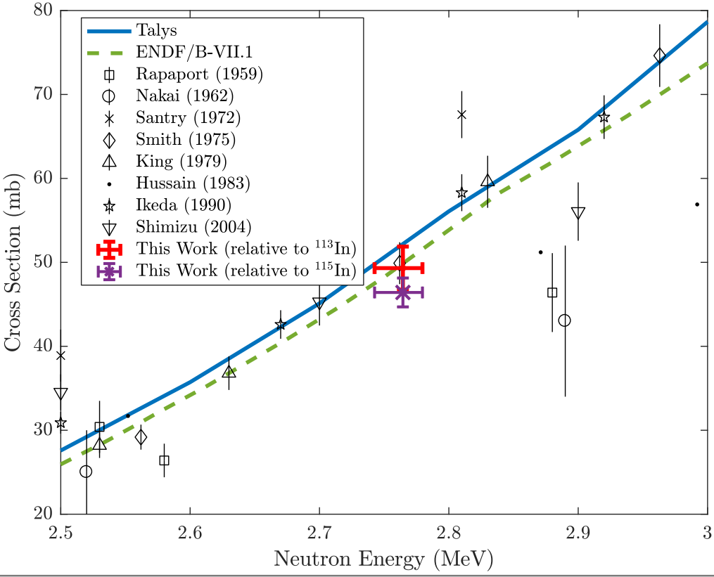
Neutron Energy Spread
⁶⁴Zn(n,p)⁶⁴Cu
After!
⁴⁷Ti(n,p)⁴⁷Sc
⁴⁷Ti(n,p)⁴⁷Sc

Slide 22
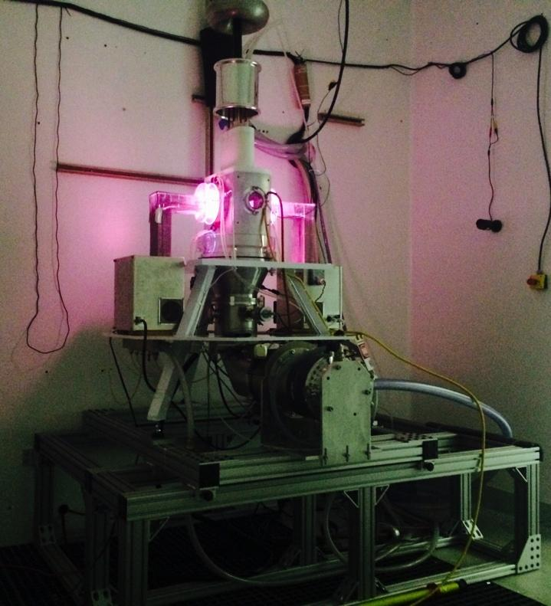
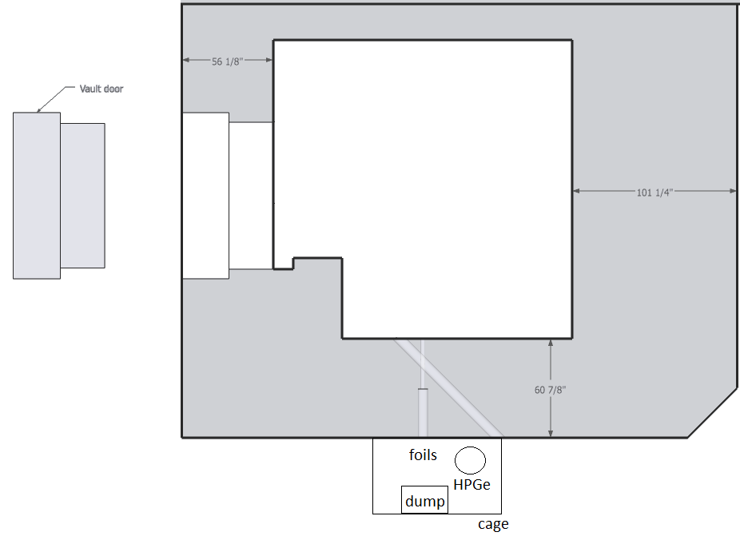
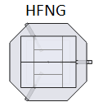
Future Work
Internal:
10⁸ n/s/cm²
Phase 1 current upgrade complete!
Target | Nuclide | Threshold (keV) | % abundance | Strongest γ-ray branch (keV) | # seen in a 0.5% Ge detector | Rate in a 0.5% detector
32S | 32P | 985 | 95% | 0 | 0.00E+00 | 0.00
47Ti | 47Ti | 0 | 7.44% | 159.381 | 1.24E+05 | 1.44
64Zn | 64Cu | 0 | 49.20% | 511 | 5.03E+05 | 5.82
67Zn | 67Cu | 0 | 4.04% | 184.577 | 5.45E+04 | 0.63
89Y | 89Sr | 726 | 100% | 908.96 | 1.25E+02 | 0.00
105Pd | 105Rh | 0 | 22.33% | 318.9 | 1.27E+05 | 1.47
149Sm | 149Pm | 291 | 11.24% | 285.94 | 4.47E+03 | 0.05
153Eu | 153Sm | 25 | 52.19% | 103.18 | 1.36E+05 | 1.58
159Tb | 159Gd | 190 | 100% | 363.543 | 1.58E+05 | 1.83
161Dy | 161Tb | 0 | 18.89% | 75.57 | 2.66E+04 | 0.31
166Er | 166Ho | 1079 | 33.50% | 1379.4 | 4.39E+03 | 0.05
169Tm | 169Er | 0 | 100% | 109.8 | 1.87E+01 | 0.00
175Lu | 175Yb | 0 | 97.40% | 396.3 | 1.88E+05 | 2.18
177Hf | 177Lu | 0 | 18.60% | 208.4 | 3.77E+04 | 0.44
Monoenergetic Beam: 10³⁻⁴ n/s/cm²

Slide 23
Stacked-target Charged Particle Excitation Functions
___________________________
^{LBNL / LANL}

Slide 24
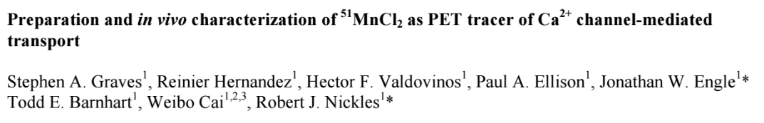
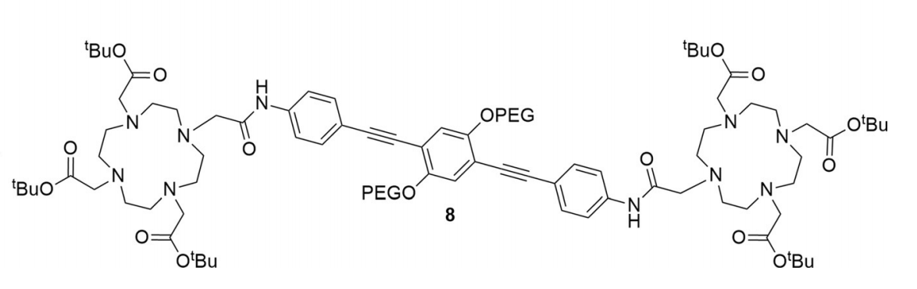
^{51,52}Mn - Motivation
Emerging medical radionuclides
⁵¹Mn (t_{1/2} = 46 min, 97% β⁺) – short-lived PET tracer for metabolic studies
^{52g}Mn (t_{1/2} = 5.6 d, 29% β⁺) – long-lived PET tracer for neuron tracking, immune studies
Manganese has well-established biochemistry and uptake via DOTA-based chelation
Almost no Fe(p,x) XS measurements exist – can use these to probe spin physics in the A≈50 region
Mn
Mn

Slide 25
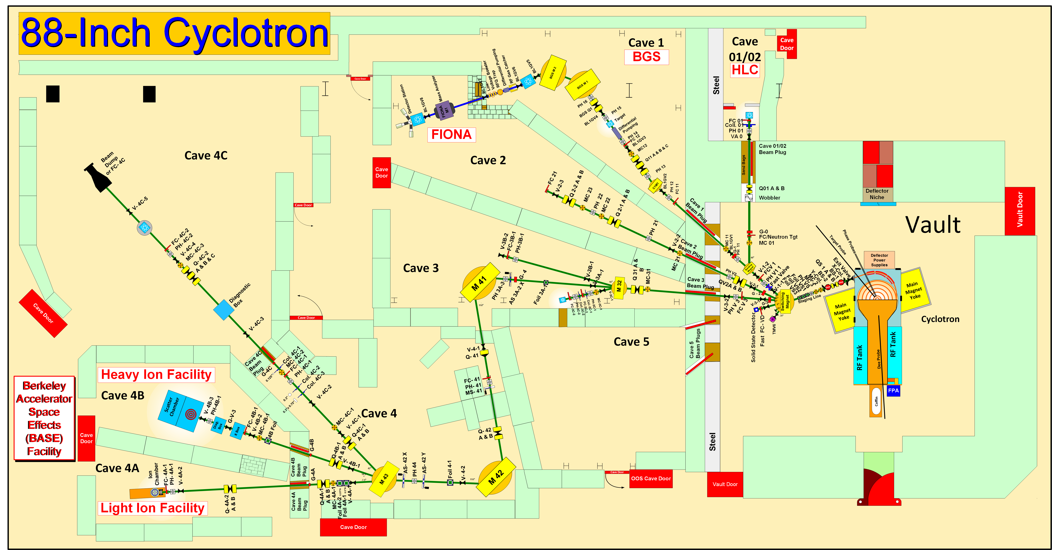
Methodology

Slide 26
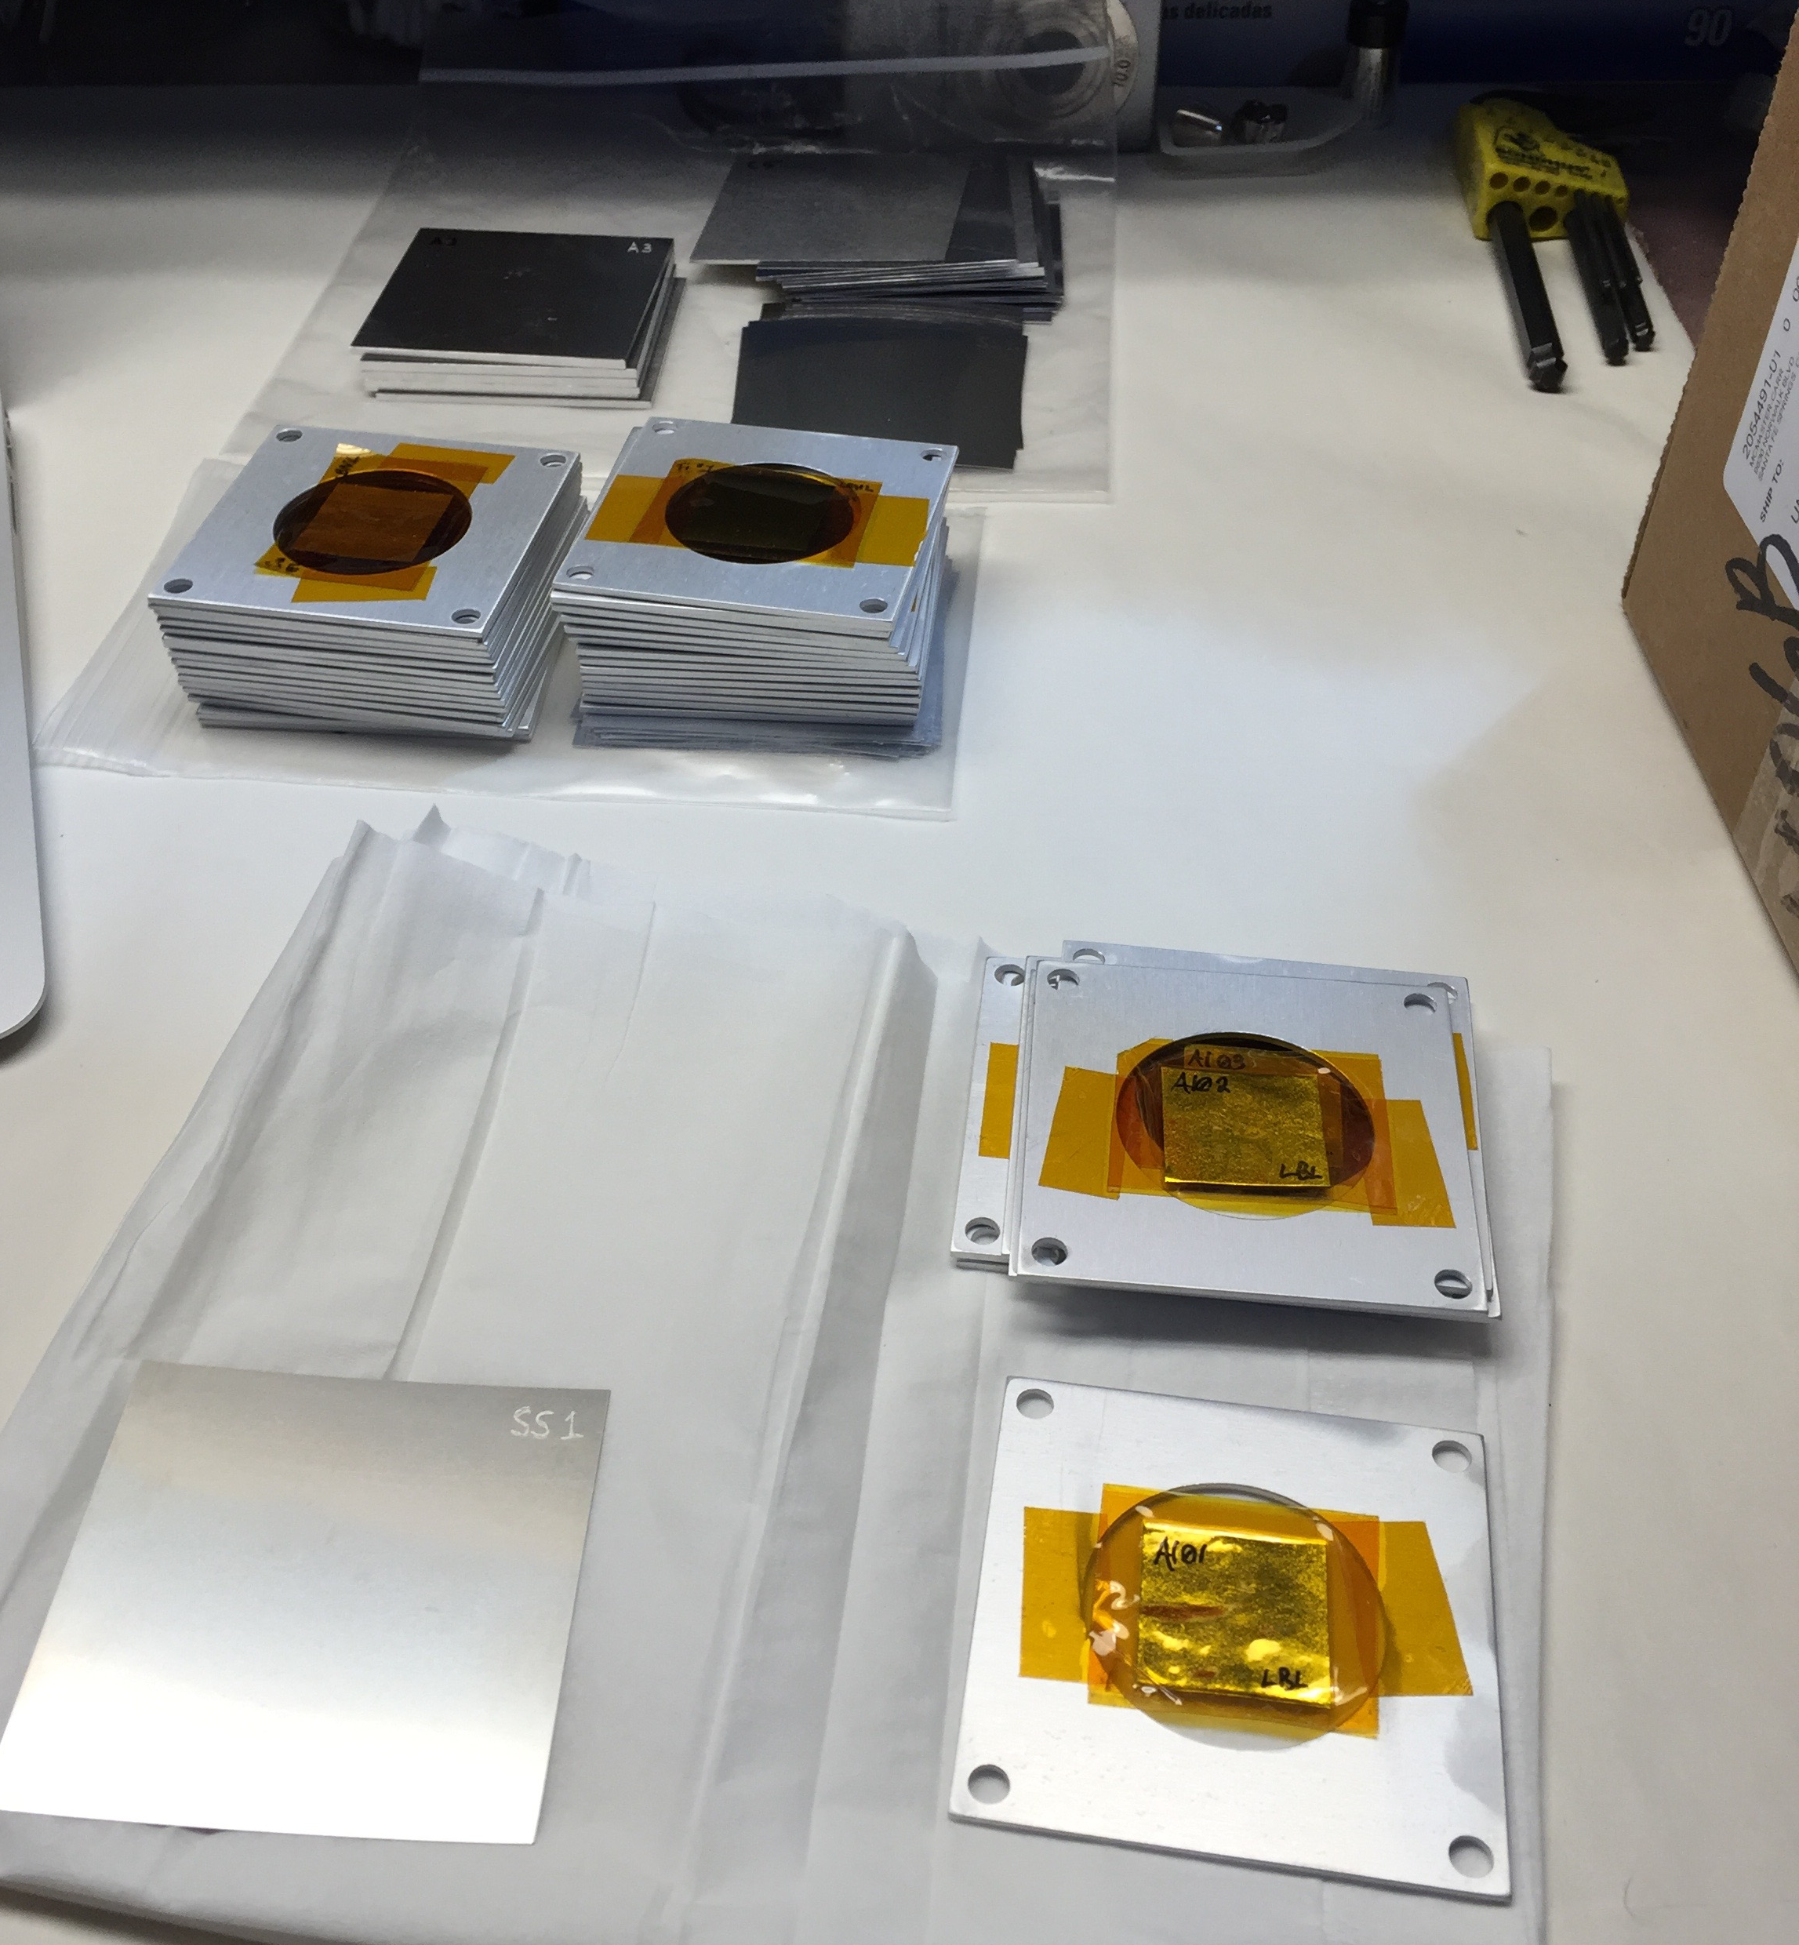
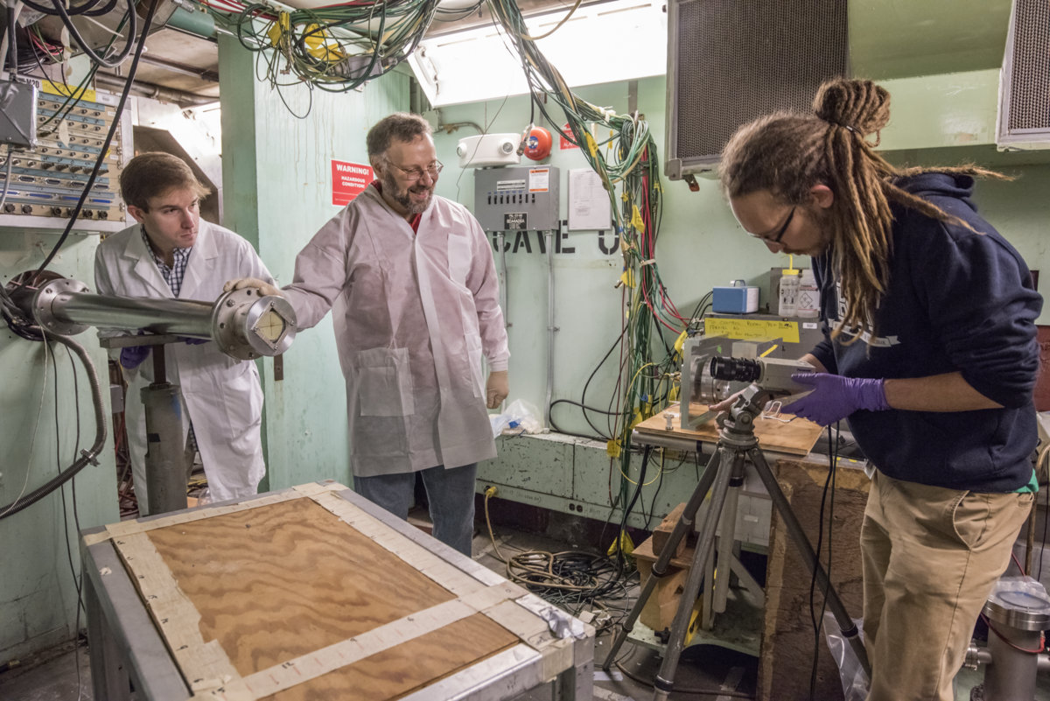
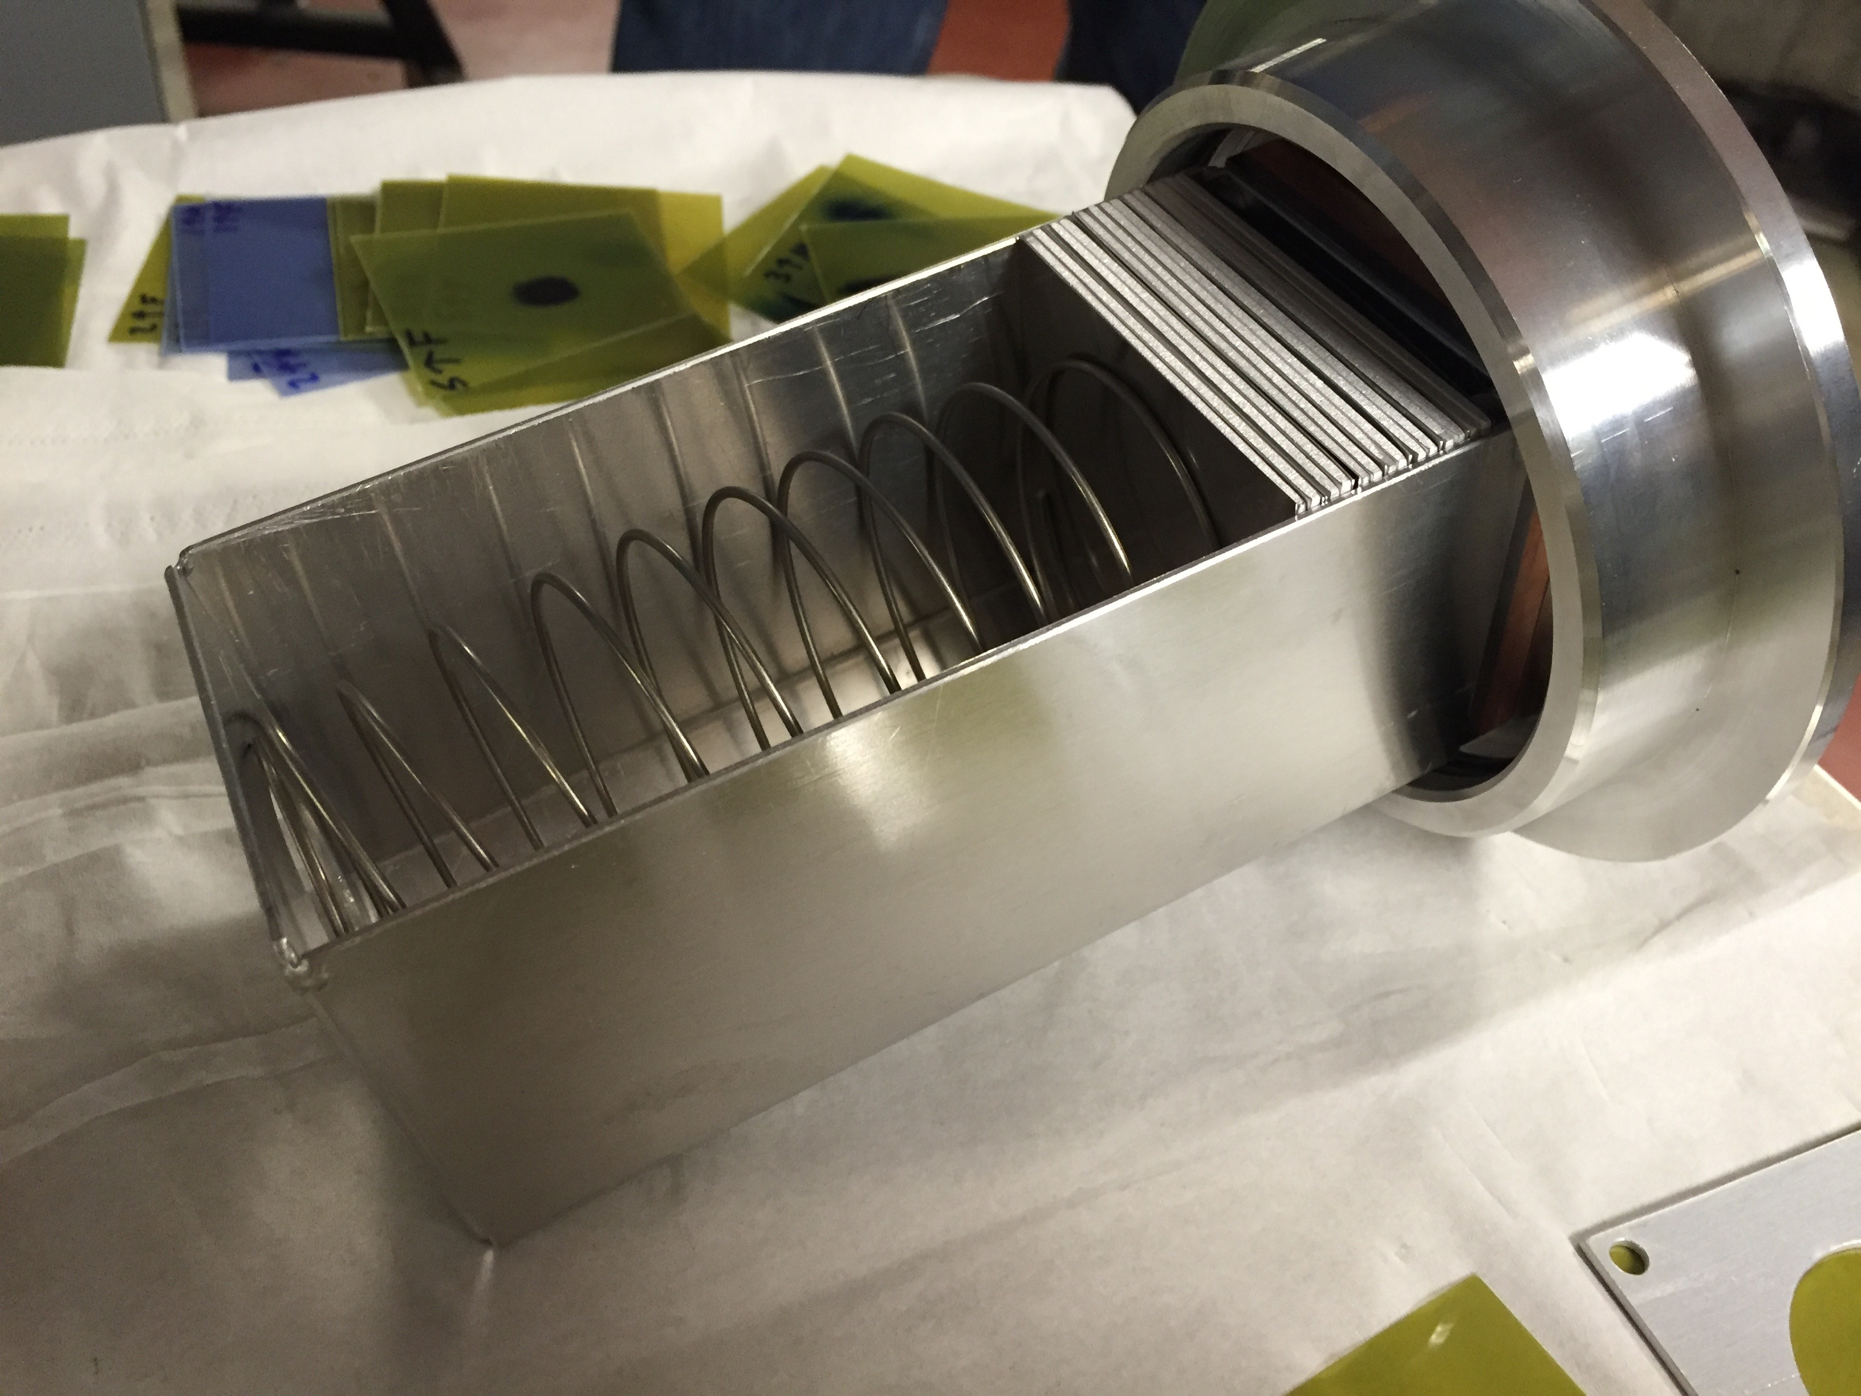
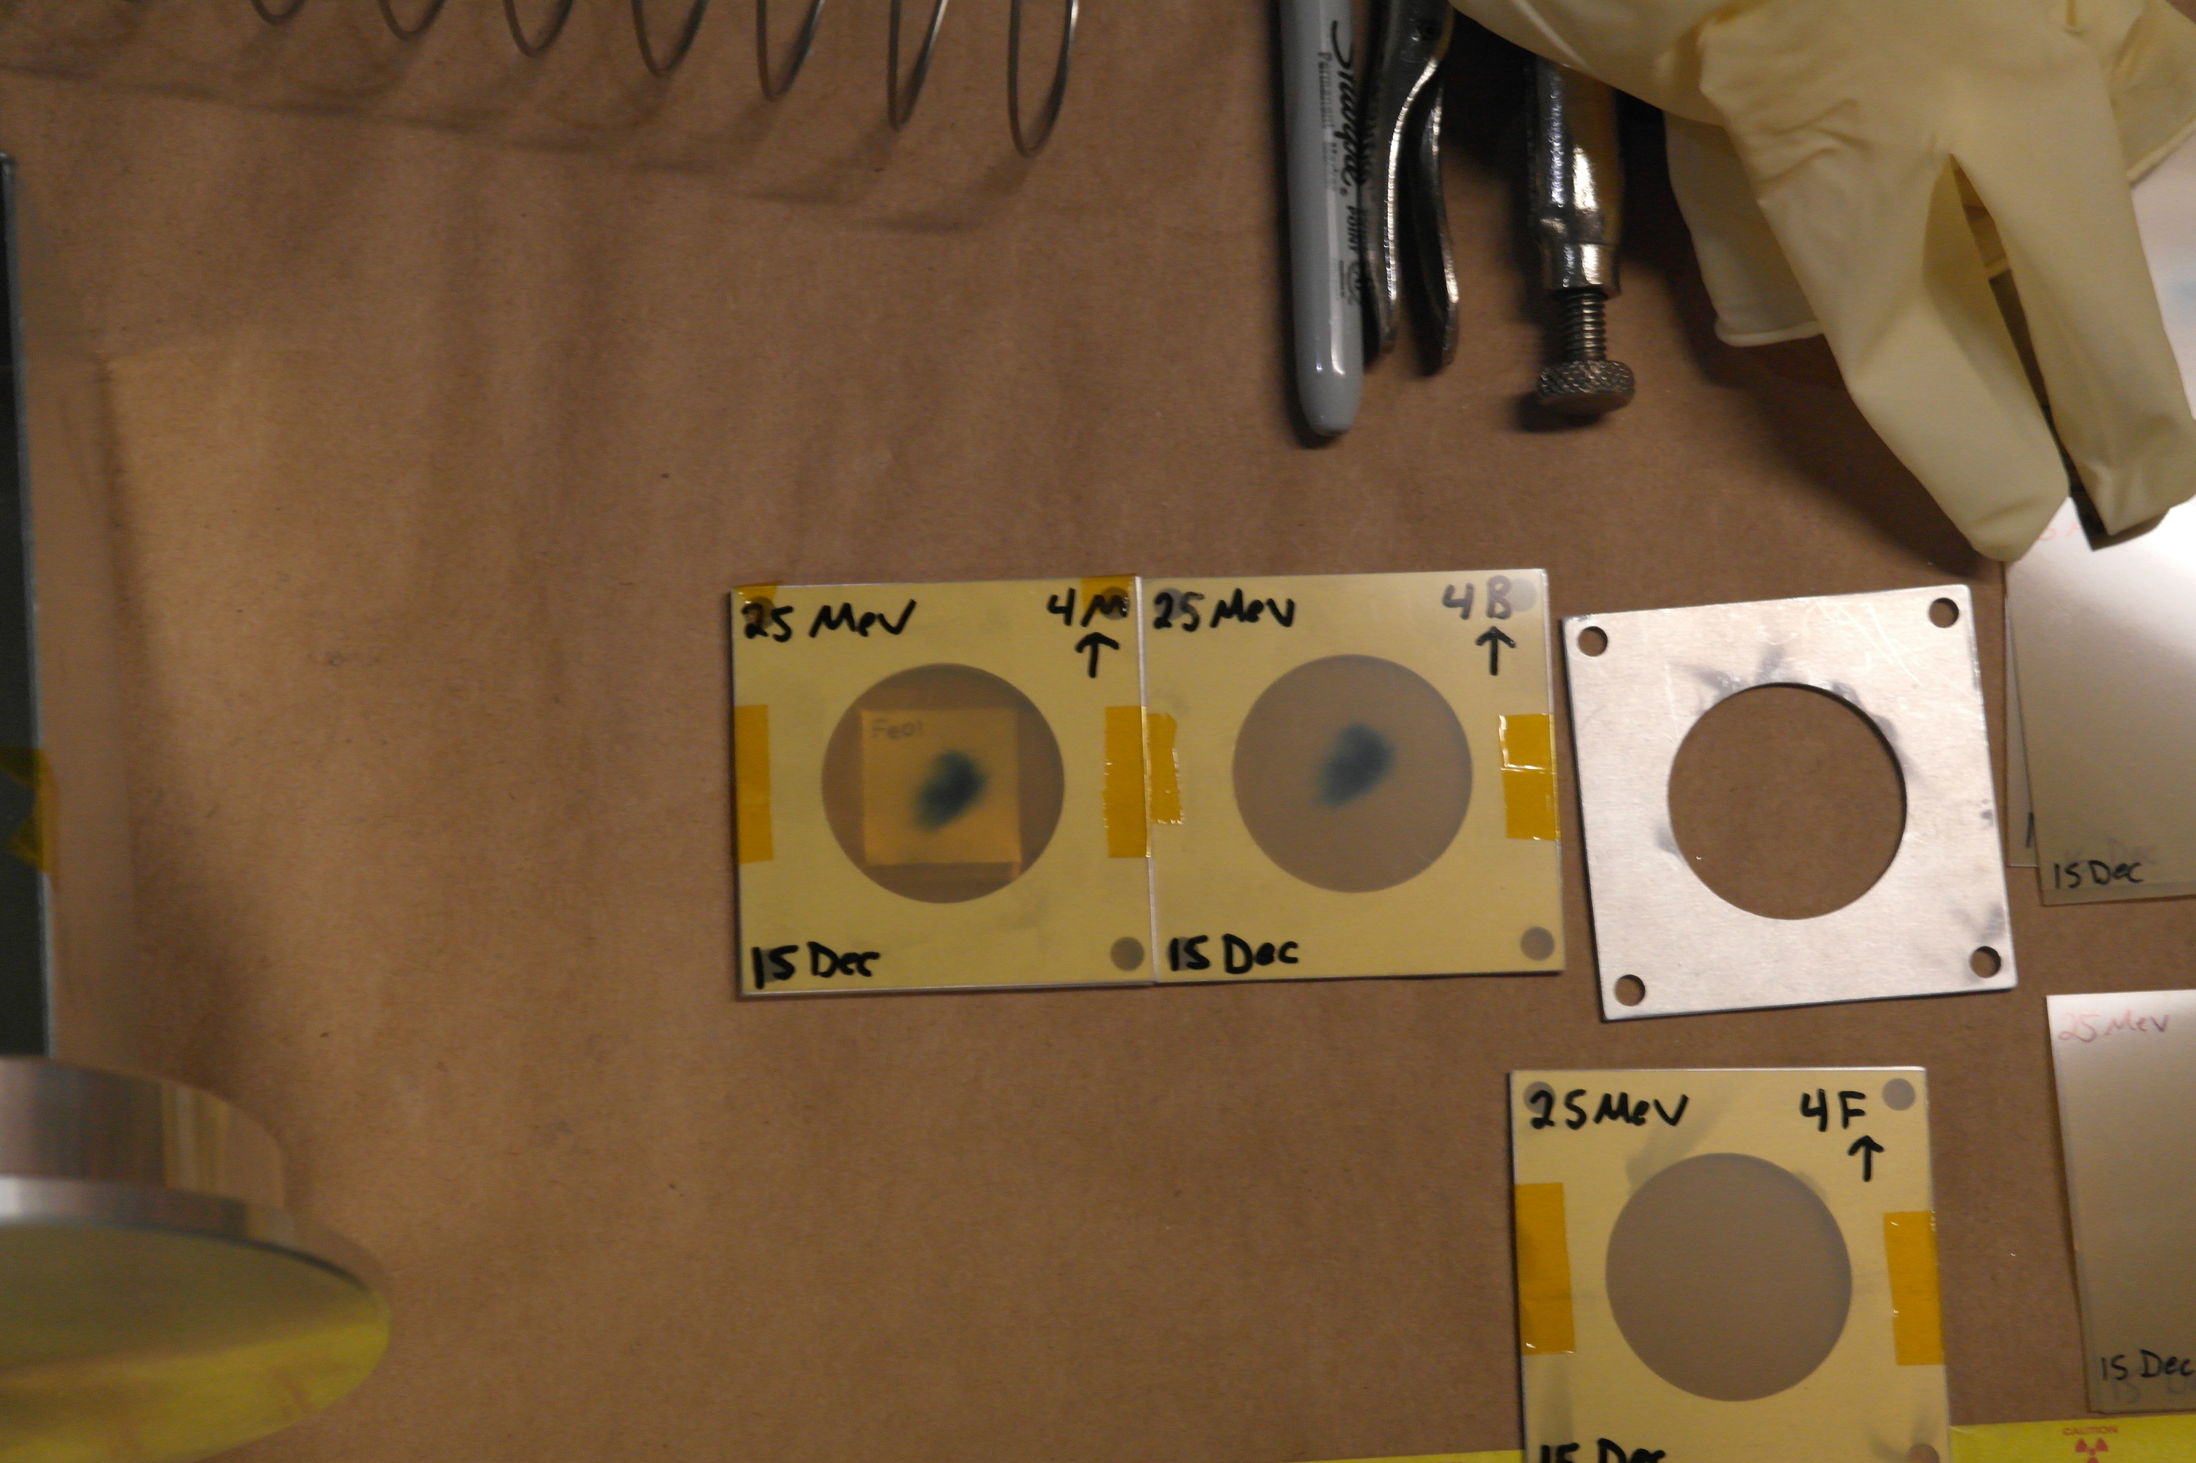
A. Springer
L. Bernstein
2.5 cm
Two overlapping stacks: E_{p}= 55→21 MeV, 25→11 MeV

Slide 27
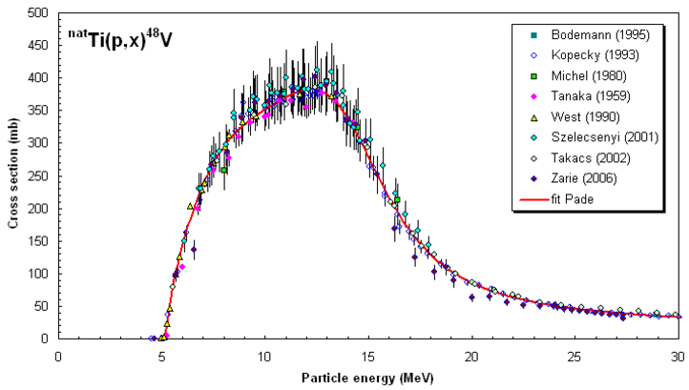
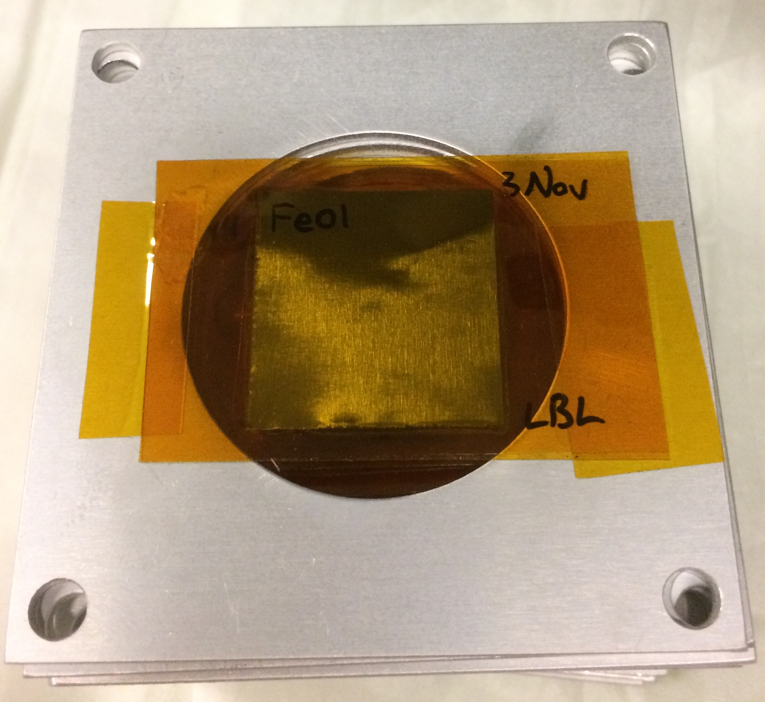
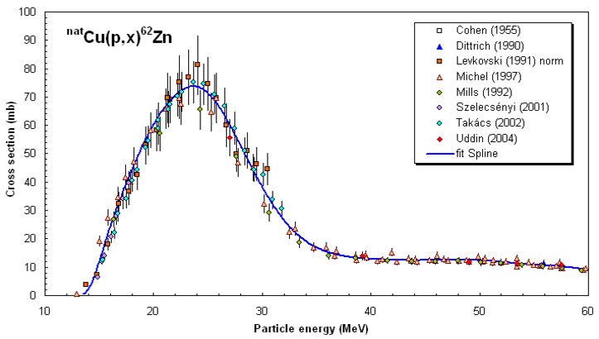
25 μm-thin ^{nat}Fe, ^{nat}Cu, ^{nat}Ti foils in 0.1” Al frames
2.5 cm
Dosimetry: IAEA charged particle beam monitor reactions:
^{nat}Ti(p,x)⁴⁸V
^{nat}Cu(p,x)^{62,63,65}Zn
nds.iaea.org/medical/monitor_reactions.html

Slide 28
Fe(p,x)
Cu(p,x)
Ti(p,x)

Slide 29
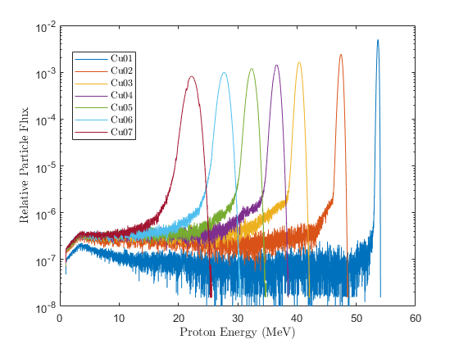
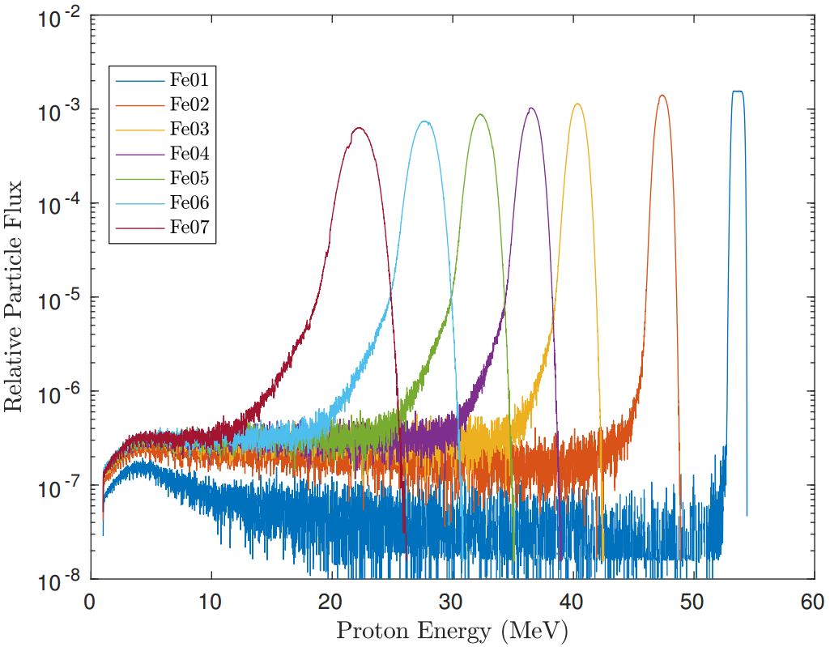
0.5% initial beam dispersion
2% initial beam dispersion

Slide 30
0.5% initial beam dispersion
2% initial beam dispersion
-σ_{<E>}
<E>
+σ_{<E>}
E_{max} = Maximum energy proton subtended by foil
F(E’) = Fraction of Total Reactions induced up to energy E’

Slide 31
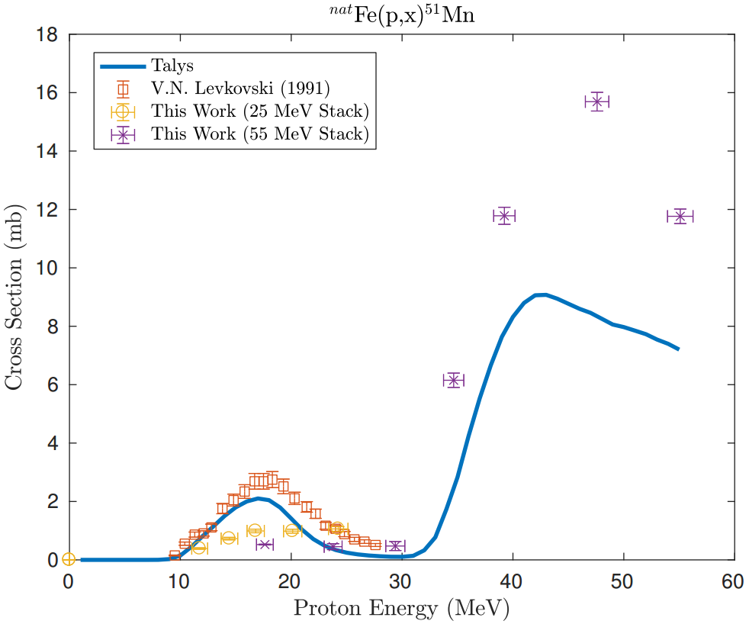
Preliminary

Slide 32
Preliminary

Slide 33
Preliminary
Results consistent with R≈1 at high energy.
At low energy, results are ambiguous due to energy straggling.

Slide 34
Measurements @ LANL – Nb(p,x)
^{nat}Nb(p,4n)⁹⁰Mo is a high-priority objective as a new proton beam dosimetry standard for E_{p} ≈ 50 – 100 MeV
Z
ε+β⁺ |  |  | ⁹⁰Mo |  |  | ^{93m}Mo | ⁹⁴Mo
IT |  |  | ^{89m}Nb ⁸⁹Nb | ⁹⁰Nb | ^{91m}Nb | ^{92m}Nb | ⁹³Nb
 | ⁸⁶Zr |  | ⁸⁸Zr | ⁸⁹Zr
 |  | ⁸⁶Y | ^{87m}Y ⁸⁷Y | ⁸⁸Y
⁸³Sr |  | ^{85m}Sr
^{82m}Rb |  |  |  |  |  |  |  | β⁺⁻
^{100 MeV} ^{p+}
N

Slide 35
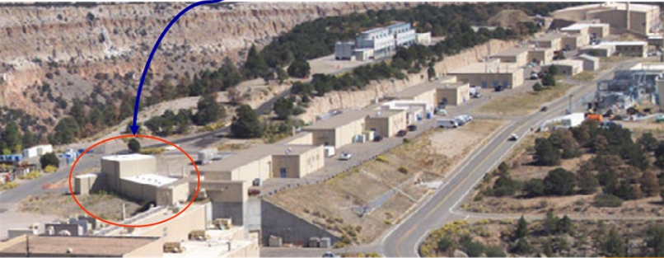
Measurements @ LANL – Nb(p,x)
IPF
Proton Injectors
201.25 MHz Drift Tube Linac
p+
805 MHz Side-Coupled Cavity Linac
To research centers
p+
p-
800 m
p-
750 keV
100 MeV
800 MeV
h+

Slide 36
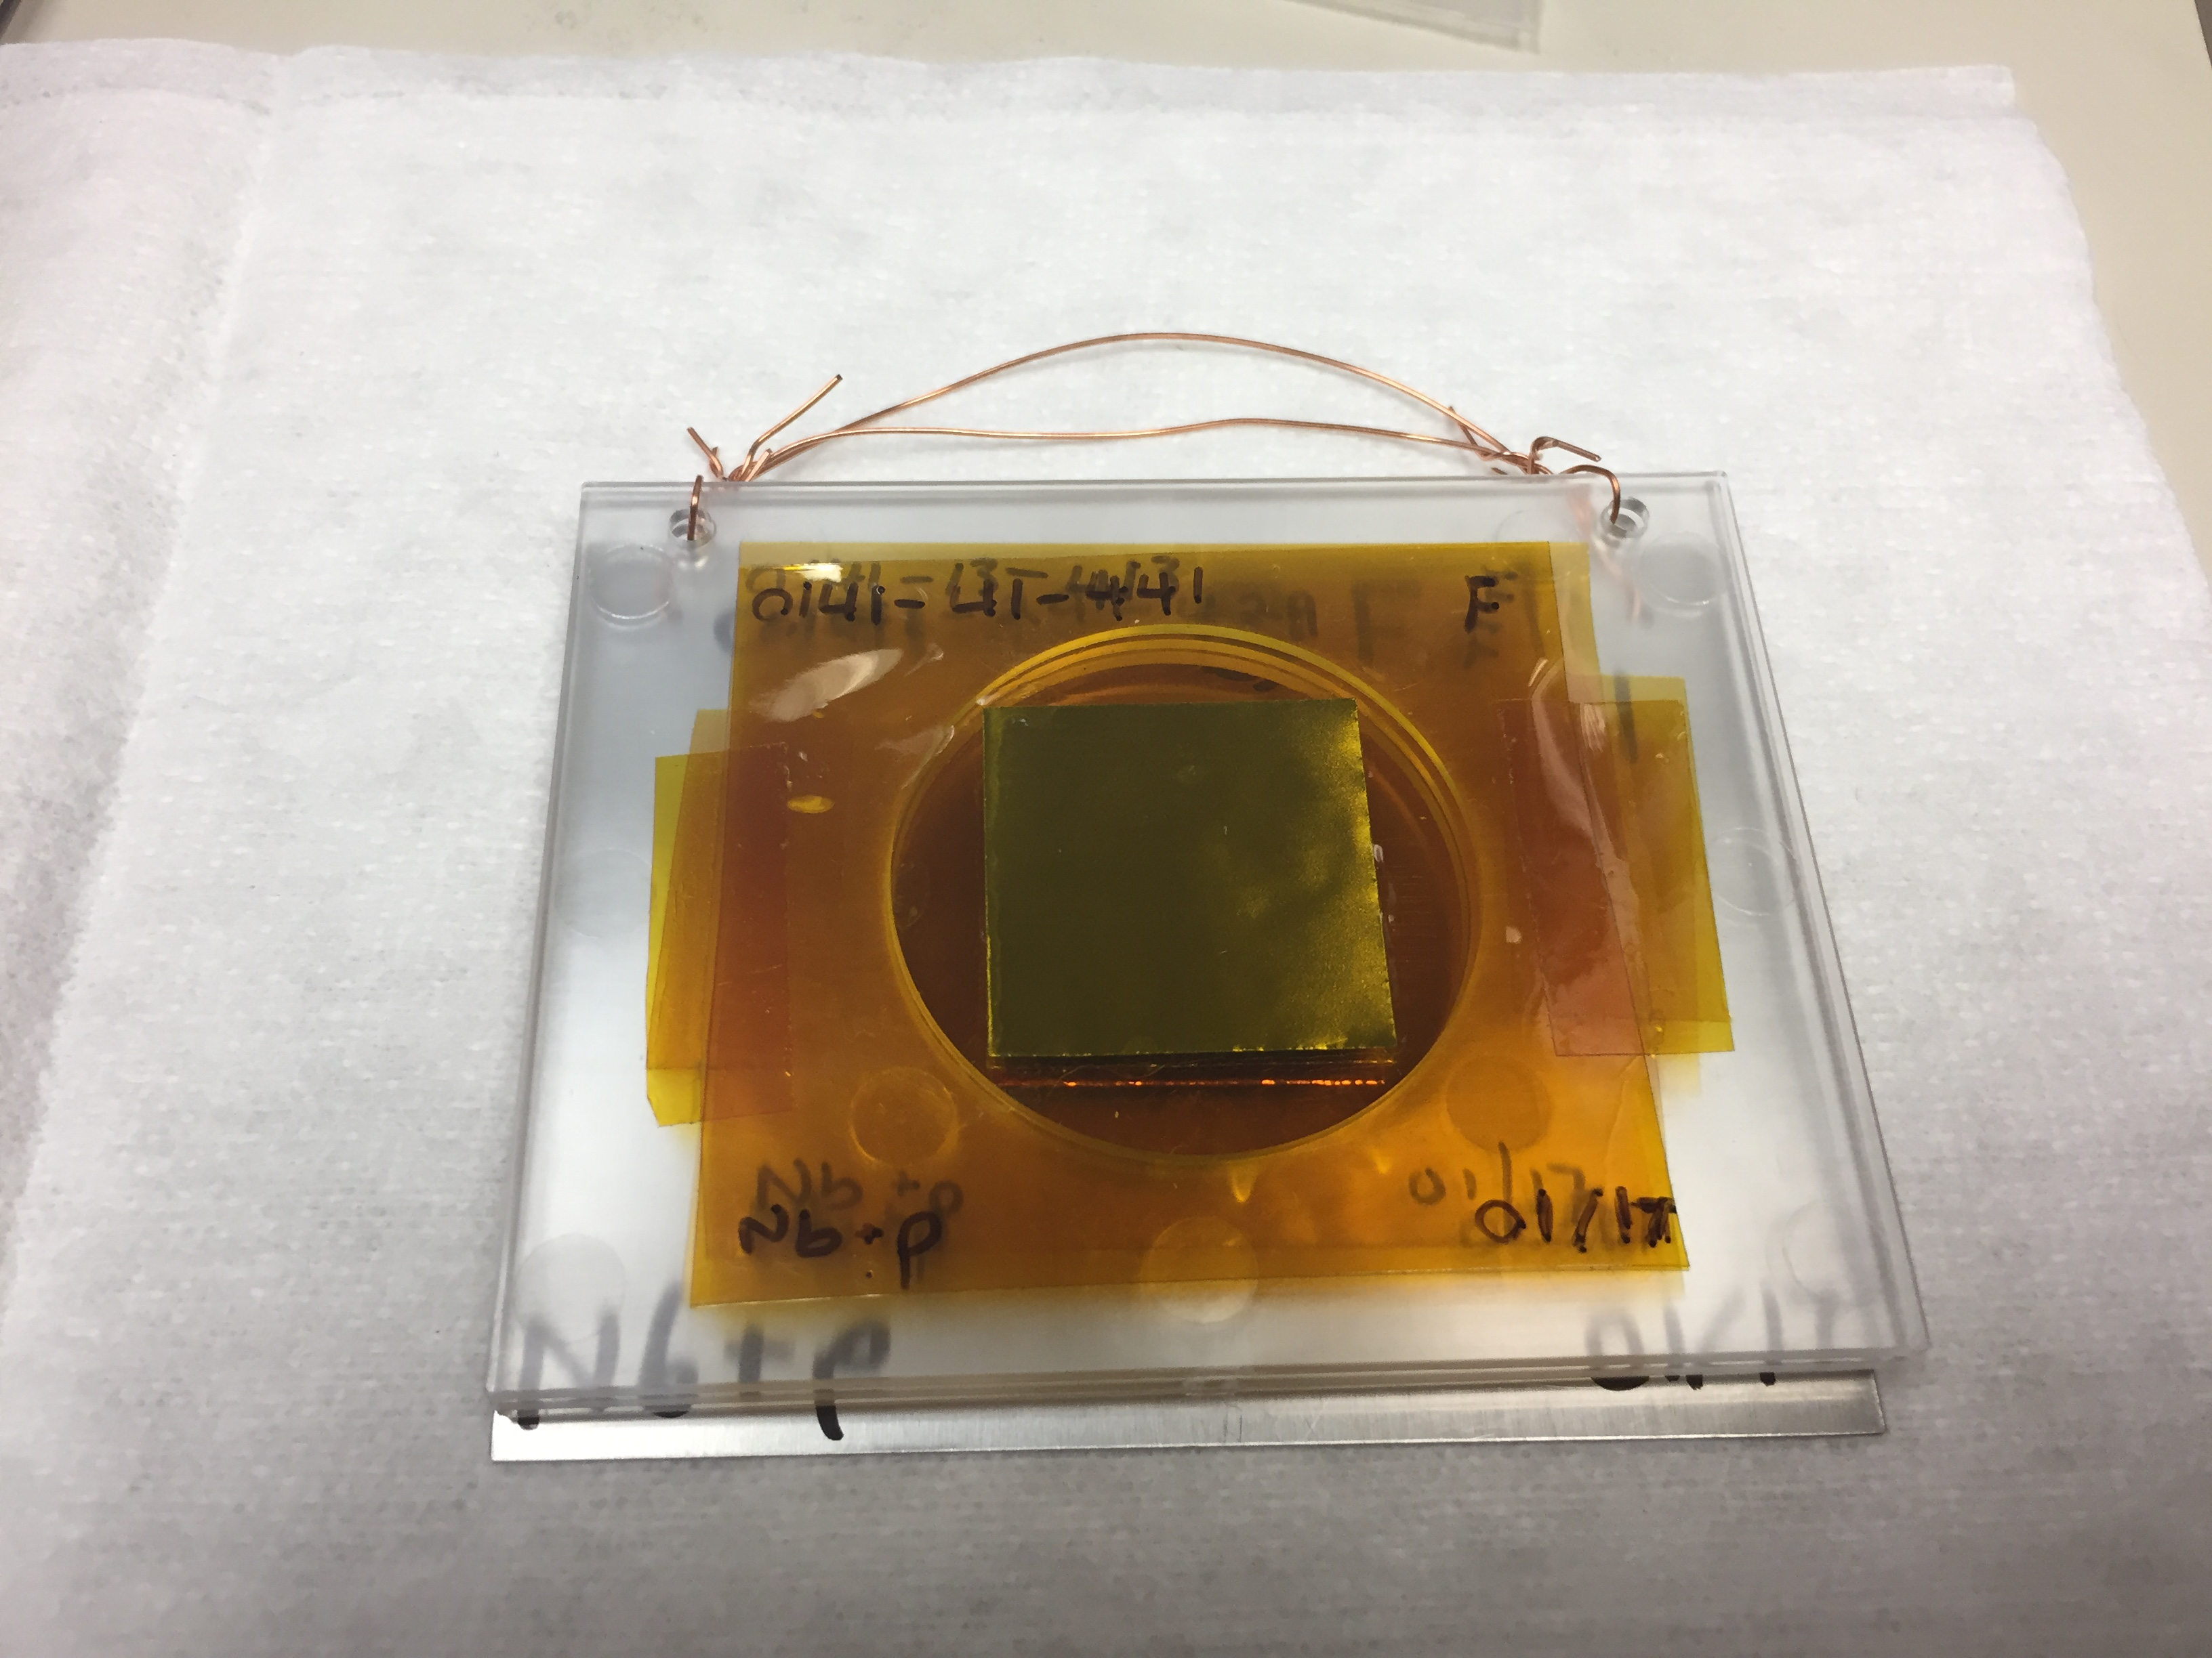
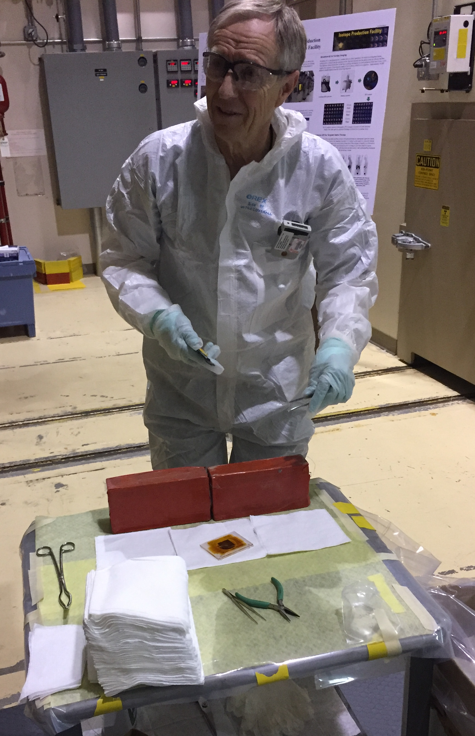
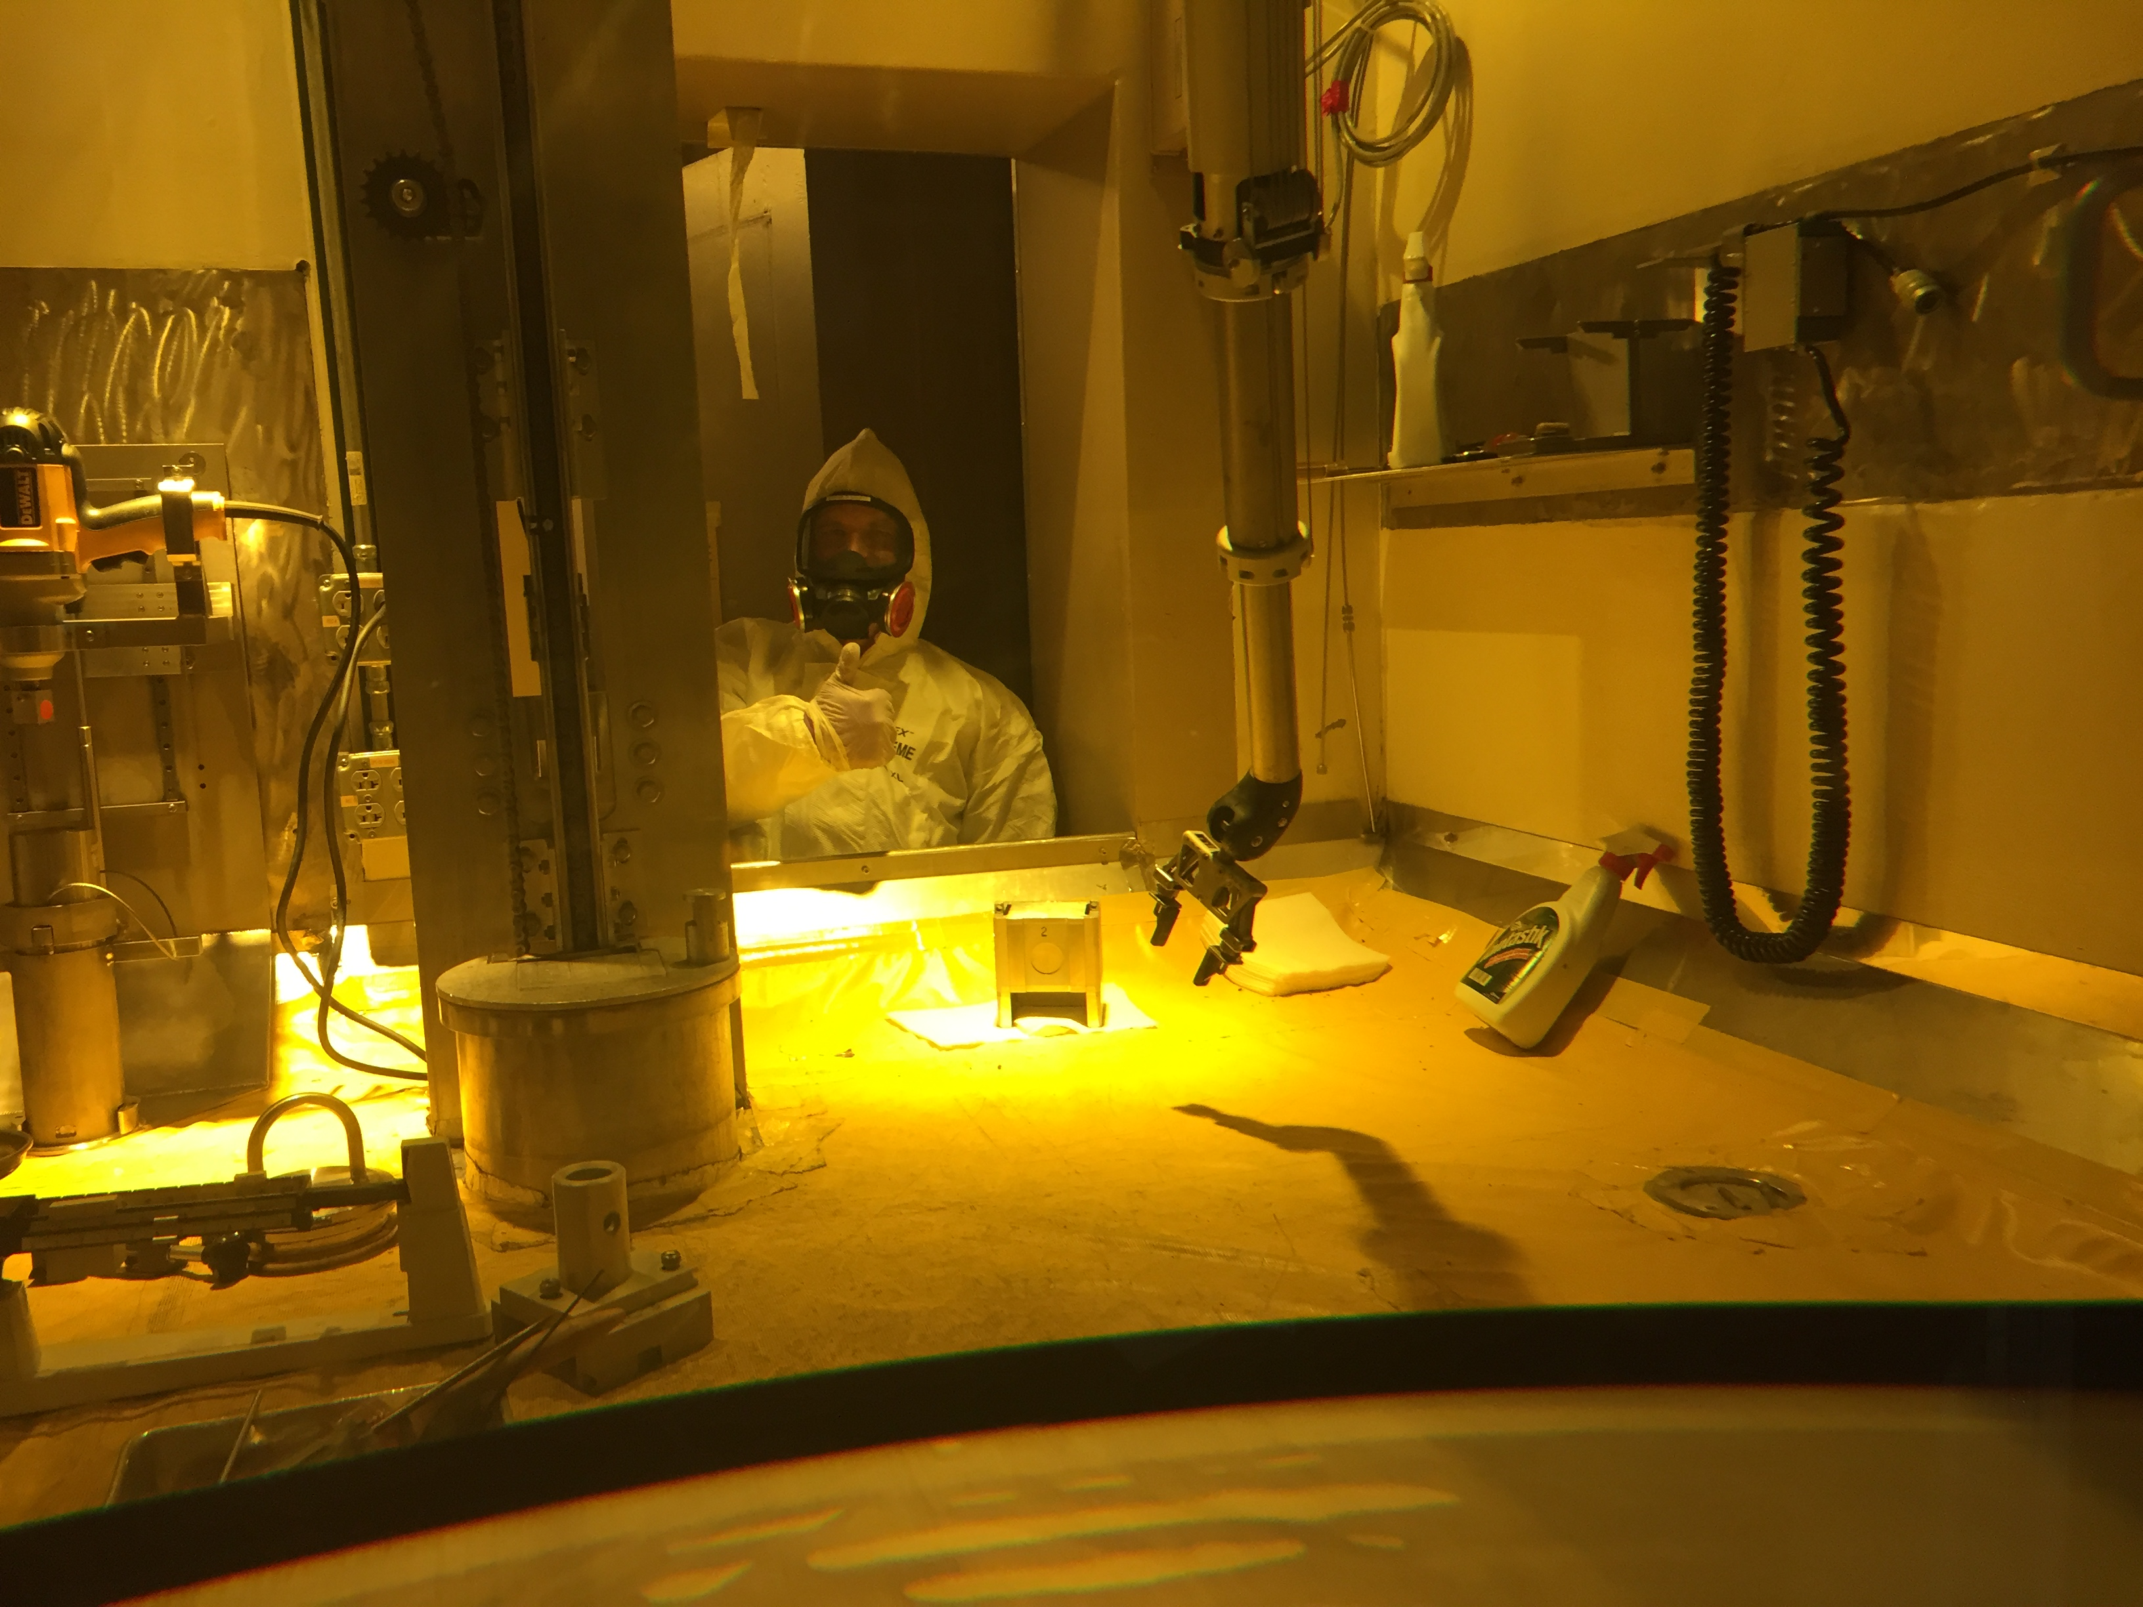
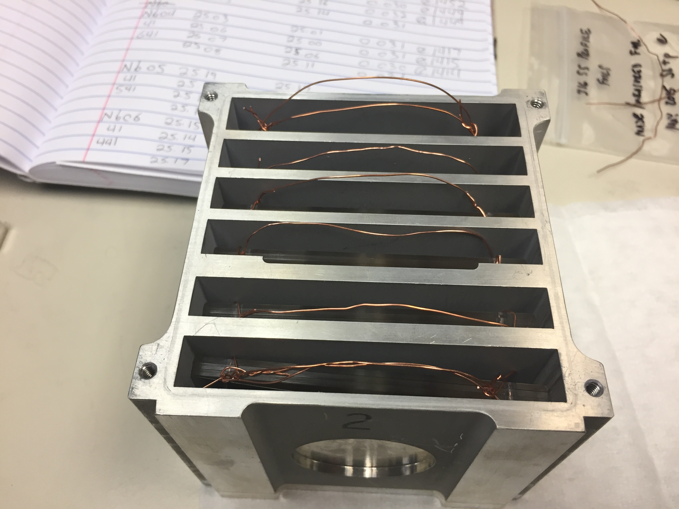
Measurements @ LANL – Nb(p,x)
LBNL: 5 – 55 MeV / A, LANL: 45 – 100 MeV p⁺
Complementary measurements explore reaction dynamics in different energy regimes, overlap region of 45-55 MeV builds confidence and consistency in results.
M. Nortier
^{100 MeV p+}

Slide 37
Measurements @ LANL – Nb(p,x)
Preliminary

Slide 38
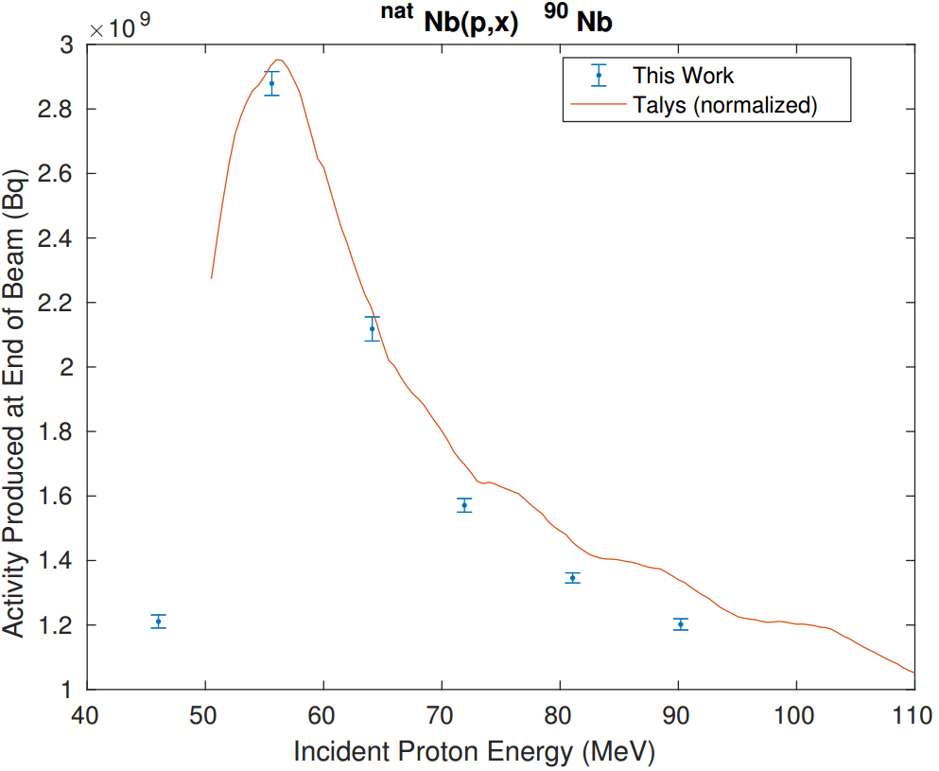
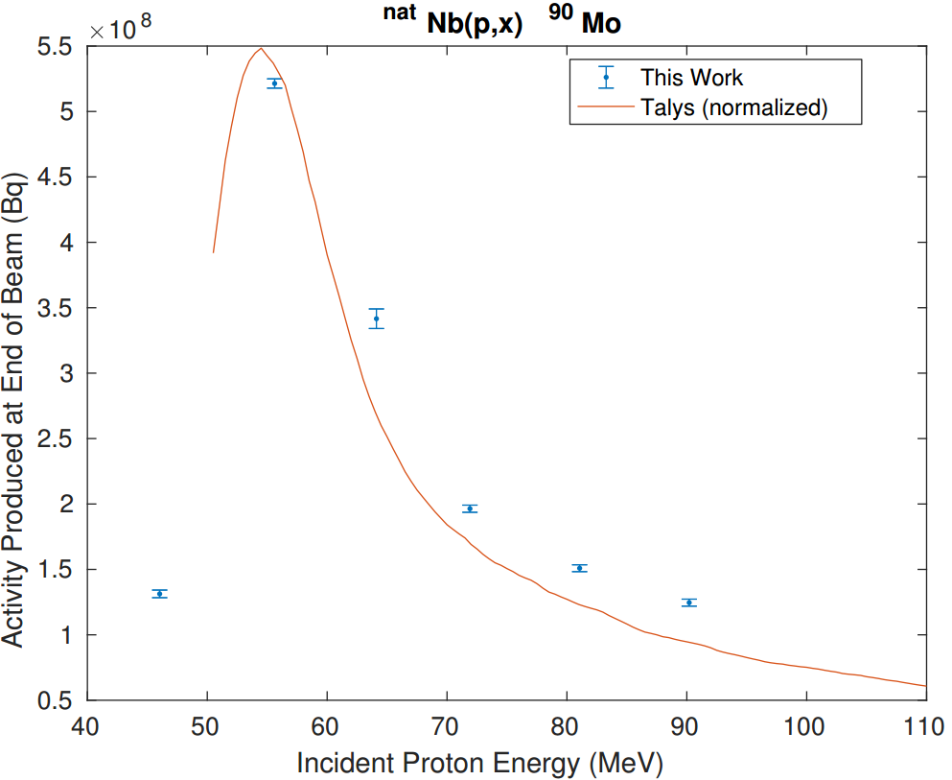
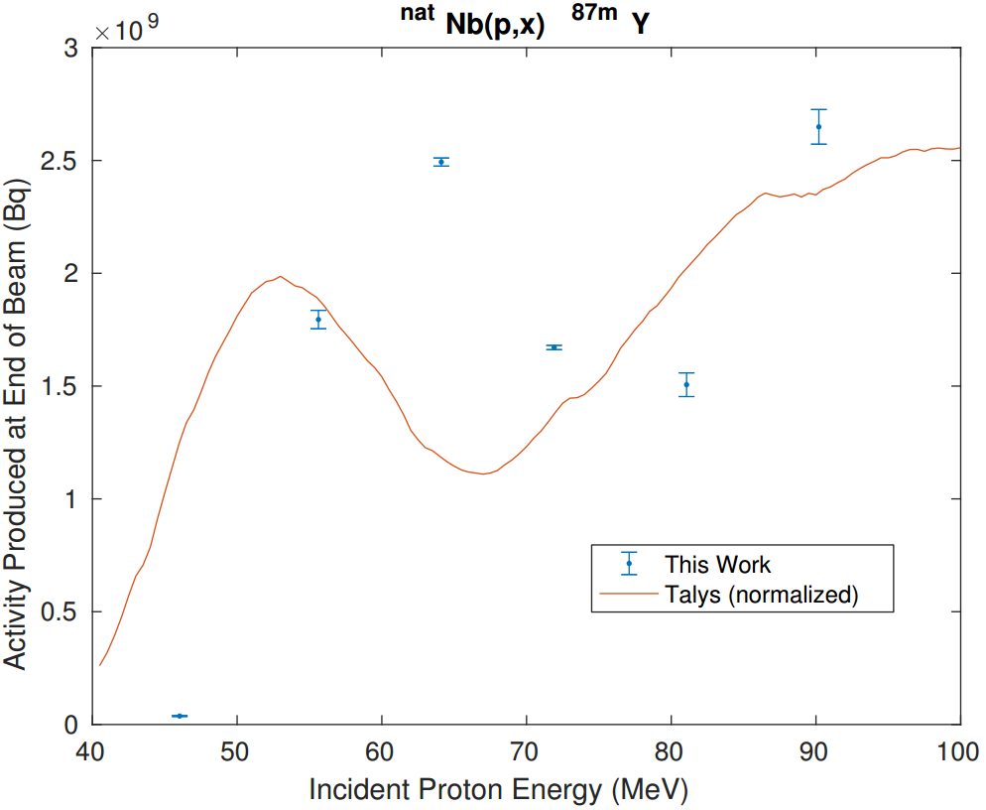
Measurements @ LANL – Nb(p,x)
Preliminary

Slide 39
Tunable Quasi-Monoenergetic Neutron Source
___________________________
^{LBNL}

Slide 40
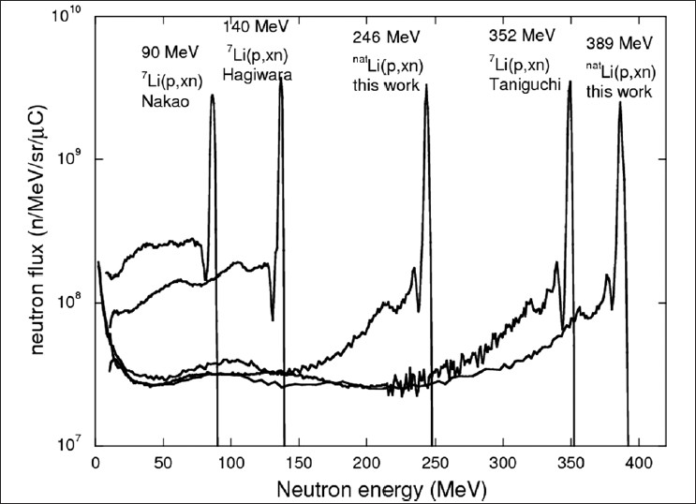
⁷Li(p,n) Neutron Sources
Nakamura, Takashi. Radiation Protection and Environment 35.3 (2012): 111.

Slide 41
⁷Li(p,n) Neutron Sources
7Li(p,n) target

Slide 42
⁷Li(p,n) Neutron Sources
Activation target
7Li(p,n) target

Slide 43
⁷Li(p,n) Neutron Sources
Measure unreacted proton current
Activation target
7Li(p,n) target

Slide 44
⁷Li(p,n) Neutron Sources
Measure unreacted proton current
Activation target
7Li(p,n) target
HPGe – primary gamma coincidences

Slide 45
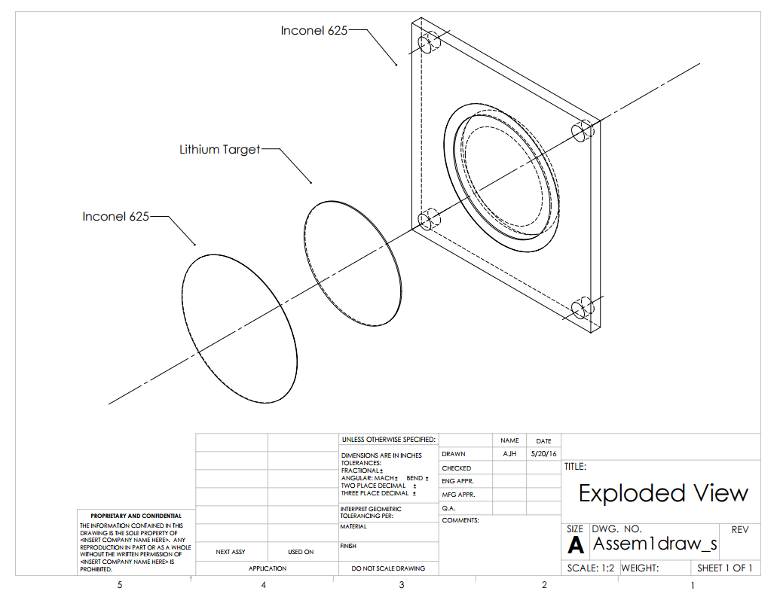
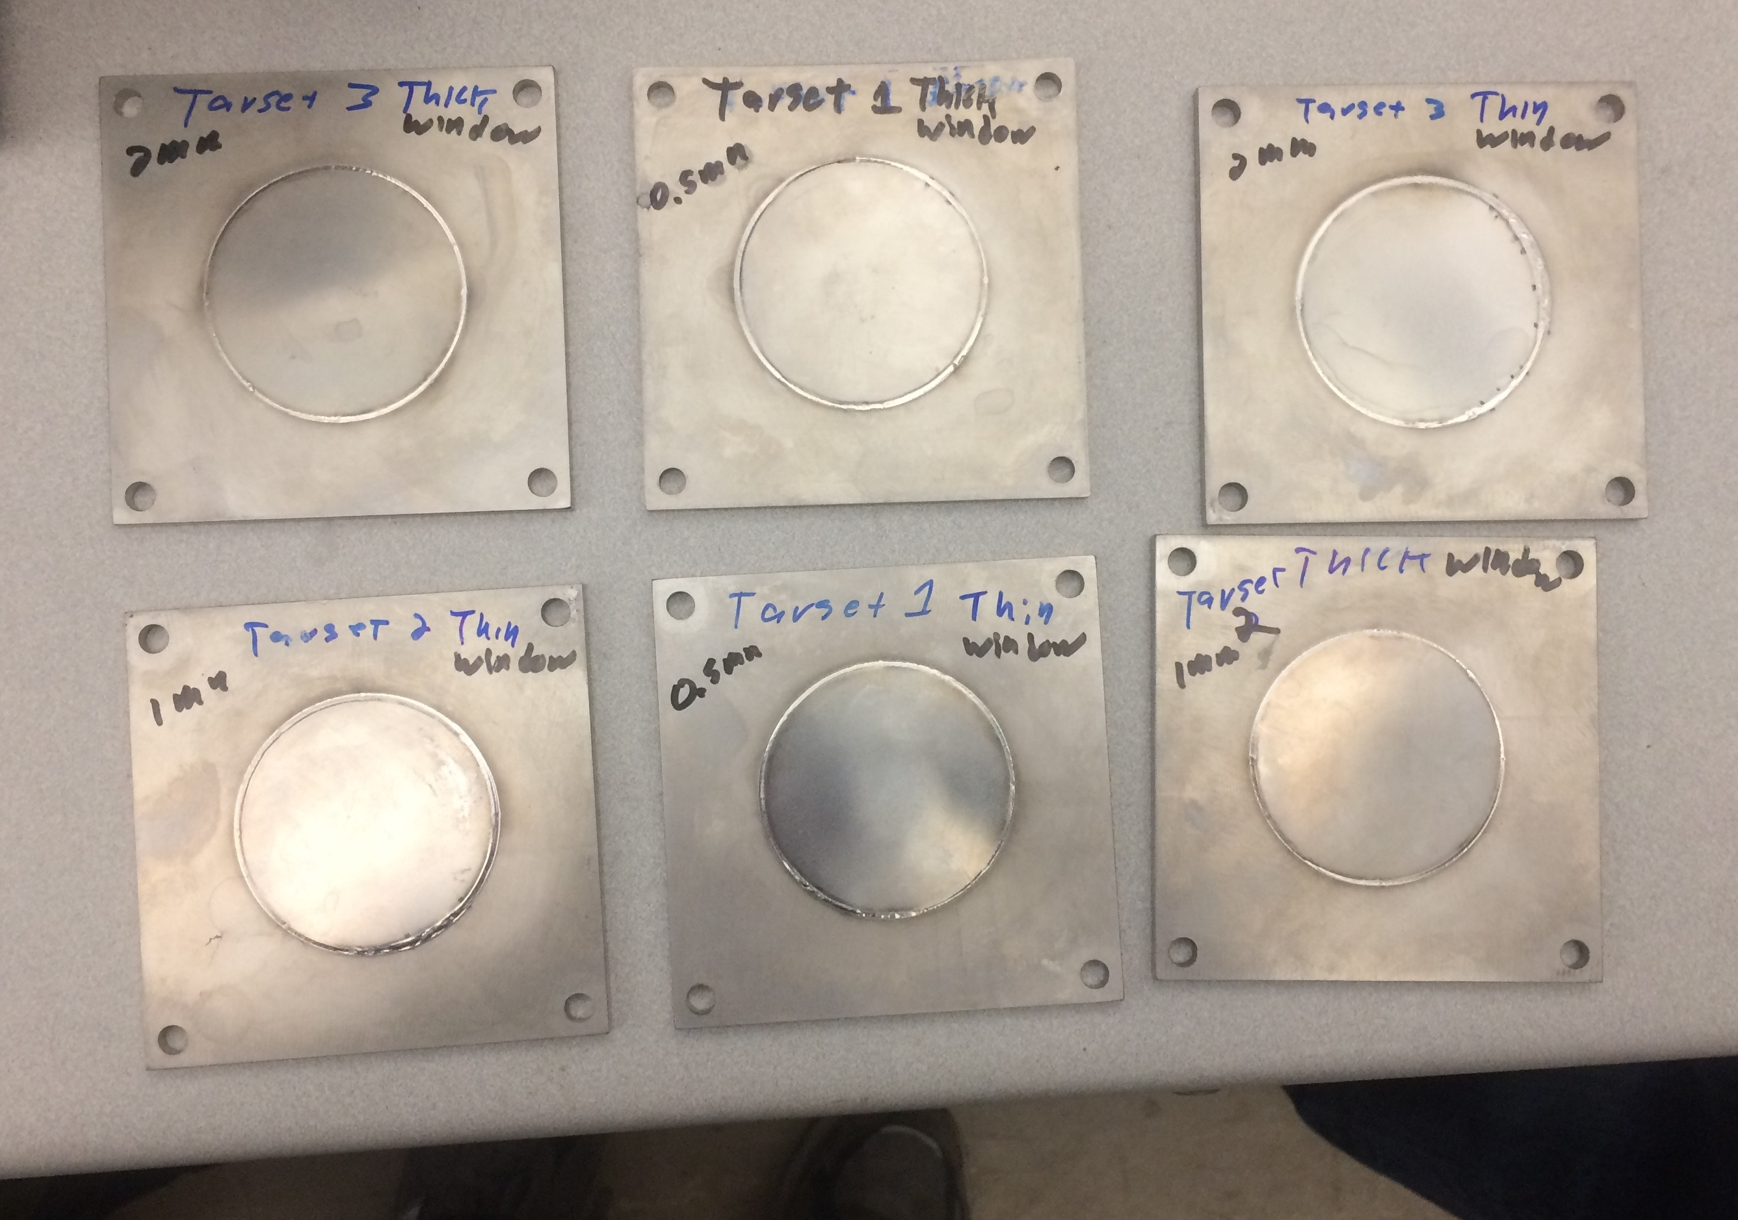
⁷Li(p,n) Neutron Sources

Slide 46
Summary
Demonstrated ability to measure R_{spin-cut} in excitation function studies for emerging medical radioisotopes
Already completed: ⁶⁴Cu and ⁴⁷Sc (n,p), Fe(p,x), Zr(d,x), Nb(p,x)
Upcoming targets: ⁸⁶Sr(p,x)⁸⁶Y, La(p,x)^{134,135}Ce, ¹⁷⁷Hf(n,p)¹⁷⁷Lu
⁷Li(p,n) quasi-monoenergetic neutron source development
Possible future candidates: Access targets previously fielded by β⁺-Oslo in the A≈50,90, rare earth regions via (p,xn), (α,xn)

Slide 47

Tusen takk!

